Slide 1
Supplemental Lecture Notes
1 - Introduction
2 - Exploratory Data Analysis
3 - Probability Theory
4 - Classical Probability Distributions
5 - Sampling Distrbns / Central Limit Theorem
6 - Statistical Inference
7 - Correlation and Regression
(8 - Survival Analysis)

Slide 2
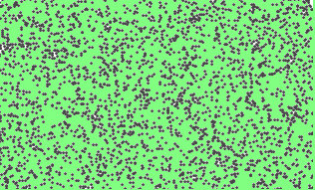
POPULATION
Probability Table
Probability Histogram
Random variable X
???
… at least if X is discrete.
(Chapter 3)
Frequency Table
Data x_{i} | Relative Frequencies p(x_{i} ) = f_{i} /n
x₁ | p(x₁)
x₂ | p(x₂)
x₃ | p(x₃)
⋮ | ⋮
x_{k} | p(x_{k})
 | 1
Density Histogram
x₁
Total Area = 1
x₃
x₂
x₆
…etc….
x₄
x₅
x_{n}
X
SAMPLE of size n

Slide 3
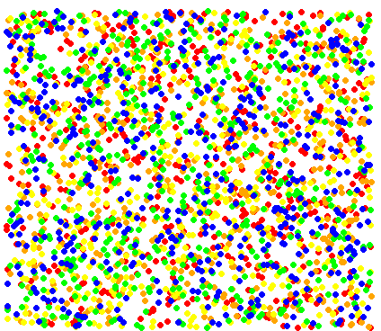
POPULATION
Definitions
(using basic Set Theory)
An outcome is the result of an experiment on a population.
Sample Space
The set of all possible outcomes of an experiment.
S = {Red, Orange, Yellow, Green, Blue}
#(S) = 5
Venn Diagram
Red
Orange
Yellow
Consider the following experiment: Randomly select an individual from the population, and record its color.
E
Green
Blue
Event
Any subset of S (including the empty set ∅, and S itself).
Outcome
Red
Orange
Yellow
Green
Blue
E = “Primary Color”
= {Red, Yellow, Blue}
#(E) = 3 ways

Slide 4
POPULATION
Definitions
(using basic Set Theory)
An outcome is the result of an experiment on a population.
Sample Space
The set of all possible outcomes of an experiment.
S = {Red, Orange, Yellow, Green, Blue}.
#(S) = 5
Venn Diagram
Red
Orange
Yellow
F
Consider the following experiment: Randomly select an individual from the population, and record its color.
Green
Blue
Event
Any subset of S (including the empty set ∅, and S itself).
Outcome
Red
Orange
Yellow
Green
Blue
E = “Primary Color”
= {Red, Yellow, Blue}
#(E) = 3 ways
F = “Hot Color”
= {Red, Orange, Yellow}
#(F) = 3 ways

Slide 5
POPULATION
Definitions
(using basic Set Theory)
An outcome is the result of an experiment on a population.
Sample Space
The set of all possible outcomes of an experiment.
S = {Red, Orange, Yellow, Green, Blue}.
#(S) = 5
Venn Diagram
Red
Orange
Yellow
F
Consider the following experiment: Randomly select an individual from the population, and record its color.
Green
Blue
Event
Any subset of S (including the empty set ∅, and S itself).
Outcome
Red
Orange
Yellow
Green
Blue
E = “Primary Color”
= {Red, Yellow, Blue}
#(E) = 3 ways
F = “Hot Color”
= {Red, Orange, Yellow}
#(F) = 3 ways
Complement F ^{C} =
“Not F” =
“Cold Color”
= {Green, Blue}
#(F^{C}) = 2 ways

Slide 6

POPULATION
Definitions
(using basic Set Theory)
An outcome is the result of an experiment on a population.
Sample Space
The set of all possible outcomes of an experiment.
S = {Red, Orange, Yellow, Green, Blue}.
#(S) = 5
Venn Diagram
Red
Orange
Yellow
F
Consider the following experiment: Randomly select an individual from the population, and record its color.
Green
Blue
Event
Any subset of S (including the empty set ∅, and S itself).
Outcome
Red
Orange
Yellow
Green
Blue
E = “Primary Color”
= {Red, Yellow, Blue}
#(E) = 3 ways
F = “Hot Color”
= {Red, Orange, Yellow}
#(F) = 3 ways
Complement F ^{C} =
“Not F” =
“Cold Color”
= {Green, Blue}
#(F^{C}) = 2 ways

Slide 7
POPULATION
Definitions
(using basic Set Theory)
An outcome is the result of an experiment on a population.
Sample Space
The set of all possible outcomes of an experiment.
S = {Red, Orange, Yellow, Green, Blue}.
#(S) = 5
Venn Diagram
Red
Orange
Yellow
F
Consider the following experiment: Randomly select an individual from the population, and record its color.
E
Green
Blue
Event
Any subset of S (including the empty set ∅, and S itself).
Outcome
Red
Orange
Yellow
Green
Blue
E = “Primary Color”
= {Red, Yellow, Blue}
#(E) = 3 ways
F = “Hot Color”
= {Red, Orange, Yellow}
#(F) = 3 ways
Complement F ^{C} =
“Not F” =
“Cold Color”
= {Green, Blue}
#(F^{C}) = 2 ways
Intersection E ⋂ F =
“E and F” =
{Red, Yellow}

Slide 8

POPULATION
Definitions
(using basic Set Theory)
An outcome is the result of an experiment on a population.
Sample Space
The set of all possible outcomes of an experiment.
S = {Red, Orange, Yellow, Green, Blue}.
#(S) = 5
Venn Diagram
Red
Orange
Yellow
F
Consider the following experiment: Randomly select an individual from the population, and record its color.
E
Green
Blue
Event
Any subset of S (including the empty set ∅, and S itself).
Outcome
Red
Orange
Yellow
Green
Blue
E = “Primary Color”
= {Red, Yellow, Blue}
#(E) = 3 ways
F = “Hot Color”
= {Red, Orange, Yellow}
#(F) = 3 ways
Complement F ^{C} =
“Not F” =
“Cold Color”
= {Green, Blue}
#(F^{C}) = 2 ways
Intersection E ⋂ F =
“E and F” =
{Red, Yellow}
#(E ⋂ F) = 2

Slide 9
POPULATION
Definitions
(using basic Set Theory)
An outcome is the result of an experiment on a population.
Sample Space
The set of all possible outcomes of an experiment.
S = {Red, Orange, Yellow, Green, Blue}.
#(S) = 5
Venn Diagram
A
B
Red
Orange
Yellow
Consider the following experiment: Randomly select an individual from the population, and record its color.
Green
Blue
Event
Any subset of S (including the empty set ∅, and S itself).
Outcome
Red
Orange
Yellow
Green
Blue
E = “Primary Color”
= {Red, Yellow, Blue}
#(E) = 3 ways
F = “Hot Color”
= {Red, Orange, Yellow}
#(F) = 3 ways
Complement F ^{C} =
“Not F” =
“Cold Color”
= {Green, Blue}
#(F^{C}) = 2 ways
Intersection E ⋂ F =
“E and F” =
{Red, Yellow}
#(E ⋂ F) = 2
Note: A = {Red, Green} ⋂ B = {Orange, Blue} =
∅
A and B are disjoint, or mutually exclusive events

Slide 10
POPULATION
Definitions
(using basic Set Theory)
An outcome is the result of an experiment on a population.
Sample Space
The set of all possible outcomes of an experiment.
S = {Red, Orange, Yellow, Green, Blue}.
#(S) = 5
Venn Diagram
Red
Orange
Yellow
F
Consider the following experiment: Randomly select an individual from the population, and record its color.
E
Green
Blue
Event
Any subset of S (including the empty set ∅, and S itself).
Outcome
Red
Orange
Yellow
Green
Blue
E = “Primary Color”
= {Red, Yellow, Blue}
#(E) = 3 ways
F = “Hot Color”
= {Red, Orange, Yellow}
#(F) = 3 ways
Complement F ^{C} =
“Not F” =
“Cold Color”
= {Green, Blue}
#(F^{C}) = 2 ways
Intersection E ⋂ F =
“E and F” =
{Red, Yellow}
#(E ⋂ F) = 2
Note: A = {Red, Green} ⋂ B = {Orange, Blue} =
∅
A and B are disjoint, or mutually exclusive events
“E or F” =

Slide 11
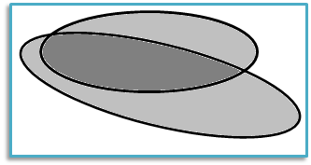
POPULATION
Definitions
(using basic Set Theory)
An outcome is the result of an experiment on a population.
Sample Space
The set of all possible outcomes of an experiment.
S = {Red, Orange, Yellow, Green, Blue}.
#(S) = 5
Venn Diagram
Red
Orange
Yellow
F
Consider the following experiment: Randomly select an individual from the population, and record its color.
E
Green
Blue
Event
Any subset of S (including the empty set ∅, and S itself).
Outcome
Red
Orange
Yellow
Green
Blue
E = “Primary Color”
= {Red, Yellow, Blue}
#(E) = 3 ways
F = “Hot Color”
= {Red, Orange, Yellow}
#(F) = 3 ways
Complement F ^{C} =
“Not F” =
“Cold Color”
= {Green, Blue}
#(F^{C}) = 2 ways
Intersection E ⋂ F =
“E and F” =
{Red, Yellow}
#(E ⋂ F) = 2
Note: A = {Red, Green} ⋂ B = {Orange, Blue} =
∅
A and B are disjoint, or mutually exclusive events
Union E ⋃ F =
“E or F” =
{Red, Orange, Yellow, Blue}
#(E ⋃ F) = 4

Slide 12

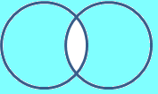
In general, for any two events A and B, there are 4 disjoint intersections:
A
B
A ⋂ B^{c}
A ⋂ B
A^{c} ⋂ B
“A only”
“A and B”
“B only”
A^{c} ⋂ B^{c}
“Neither A nor B”
DeMorgan’s Laws
(A ⋃ B)^{c} = A^{c} ⋂ B^{c}
“Not (A or B)” = “Not A” and “Not B”
= “Neither A nor B”
(A ⋂ B)^{c} = A^{c} ⋃ B^{c}
“Not (A and B)” = “Not A” or “Not B”
A B
A B

Slide 13
In general, for any two events A and B, there are 4 disjoint intersections:
B^{c}
B
A
A ⋂ B^{c}
A ⋂ B
A^{c} ⋂ B
“A only”
“A and B”
“B only”
A^{c} ⋂ B^{c}
“Neither A nor B”
DeMorgan’s Laws
(A ⋃ B)^{c} = A^{c} ⋂ B^{c}
“Not (A or B)” = “Not A” and “Not B”
= “Neither A nor B”
(A ⋂ B)^{c} = A^{c} ⋃ B^{c}
“Not (A and B)” = “Not A” or “Not B”
A B
A B

Slide 14
POPULATION
Definitions
(using basic Set Theory)
An outcome is the result of an experiment on a population.
Sample Space
The set of all possible outcomes of an experiment.
S = {Red, Orange, Yellow, Green, Blue}.
#(S) = 5
Venn Diagram
Red
Orange
Yellow
F
Consider the following experiment: Randomly select an individual from the population, and record its color.
E
Green
Blue
Event
Any subset of S (including the empty set ∅, and S itself).
Outcome
Red
Orange
Yellow
Green
Blue
What about probability of outcomes?
E = “Primary Color”
= {Red, Yellow, Blue}
#(E) = 3 ways
F = “Hot Color”
= {Red, Orange, Yellow}
#(F) = 3 ways
Complement F ^{C} =
“Not F” =
“Cold Color”
= {Green, Blue}
#(F^{C}) = 2 ways
Intersection E ⋂ F =
“E and F” =
{Red, Yellow}
#(E ⋂ F) = 2
Note: A = {Red, Green} ⋂ B = {Orange, Blue} =
∅
A and B are disjoint, or mutually exclusive events
Union E ⋃ F =
“E or F” =
{Red, Orange, Yellow, Blue}
#(E ⋃ F) = 4

Slide 15
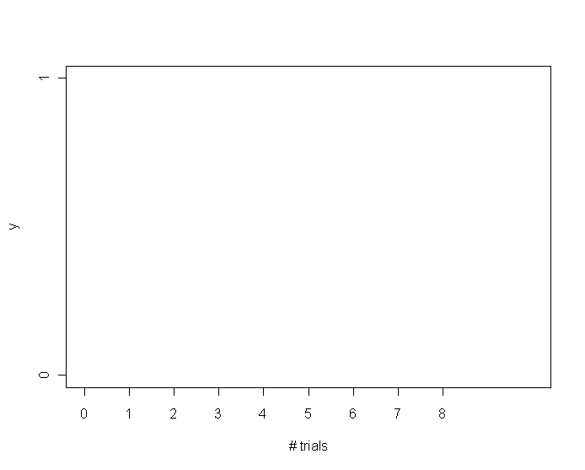
POPULATION (Pie Chart)
Definitions
(using basic Set Theory)
POPULATION
An outcome is the result of an experiment on a population.
Sample Space
The set of all possible outcomes of an experiment.
S = {Red, Orange, Yellow, Green, Blue}.
#(S) = 5
Venn Diagram
Red
Orange
Yellow
F
Perform repeated trials of the following experiment: Randomly select an individual from the population, and record its color.
E
Consider the following experiment: Randomly select an individual from the population, and record its color.
Green
Blue
Event
Any subset of S (including the empty set ∅, and S itself).
# Red
# trials
Outcome
Red
Orange
Yellow
Green
Blue
Outcome | Probability
Red | 0.20
Orange | 0.20
Yellow | 0.20
Green | 0.20
Blue | 0.20
 | 1.00
E = “Primary Color”
= {Red, Yellow, Blue}
#(E) = 3 ways
“The probability of Red is equal to 0.20”
F = “Hot Color”
= {Red, Orange, Yellow}
#(F) = 3 ways
What happens to this “long run” relative frequency as # trials → ∞?
Complement F ^{C} =
“Not F” =
“Cold Color”
= {Green, Blue}
P(Red) = 0.20
#(F^{C}) = 2 ways
…… But what does it mean??
Intersection E ⋂ F =
“E and F“ =
{Red, Yellow}
#(E ⋂ F) = 2
Note: A = {Red, Green} ⋂ B = {Orange, Blue} =
∅
…
A and B are disjoint, or mutually exclusive events
Union E ⋃ F =
“E or F” =
{Red, Orange, Yellow, Blue}
# trials
All probs are > 0, and sum = 1.
#(E ⋃ F) = 4

Slide 16
POPULATION (Pie Chart)
# R code for colors.r
R = rep("Red", 100000)
O = rep("Orange", 100000)
Y = rep("Yellow", 100000)
G = rep("Green", 100000)
B = rep("Blue", 100000)
pop = c(R, O, Y, G, B)
plot.new()
plot(0, 0, type = "n", axes = F, xlim = c(0, 300), ylim = c(0, 1), xlab = "n = # Trials", ylab = "#(Red) / n")
axis(1)
axis(2)
box()
lines(c(0, 300), c(.2, .2), lty = 2)
i = 0
for (n in 1:300) {
color = sample(pop, 1, replace = TRUE)
if (color == "Red") i = i+1
relfreq = i/n
points(n, relfreq, pch=19, cex = .5, col = "red") }
Consider the following experiment: Randomly select an individual from the population, and record its color.
Perform repeated trials of the following experiment: Randomly select an individual from the population, and record its color.
Event
Any subset of S (including the empty set ∅, and S itself).
Outcome
Red
Orange
Yellow
Green
Blue
Outcome | Probability
Red | 0.20
Orange | 0.20
Yellow | 0.20
Green | 0.20
Blue | 0.20
 | 1.00
E = “Primary Color”
= {Red, Yellow, Blue}
#(E) = 3 ways
“The probability of Red is equal to 0.20”
F = “Hot Color”
= {Red, Orange, Yellow}
#(F) = 3 ways
Complement F ^{C} =
“Not F” =
“Cold Color”
= {Green, Blue}
P(Red) = 0.20
#(F^{C}) = 2 ways
…… But what does it mean??
Intersection E ⋂ F =
“E and F“ =
{Red, Yellow}
#(E ⋂ F) = 2
Note: A = {Red, Green} ⋂ B = {Orange, Blue} =
∅
…
A and B are disjoint, or mutually exclusive events
Union E ⋃ F =
“E or F” =
{Red, Orange, Yellow, Blue}
All probs are > 0, and sum = 1.
#(E ⋃ F) = 4

Slide 17
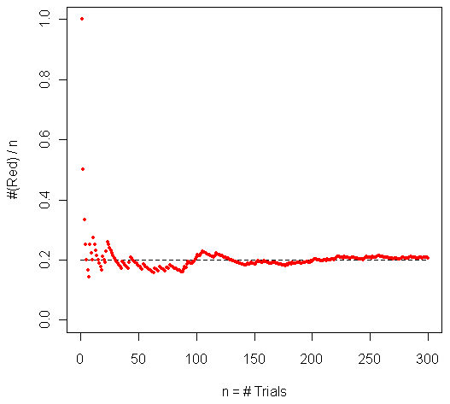
POPULATION (Pie Chart)
Definitions
(using basic Set Theory)
An outcome is the result of an experiment on a population.
Sample Space
The set of all possible outcomes of an experiment.
S = {Red, Orange, Yellow, Green, Blue}.
#(S) = 5
Venn Diagram
Red
Orange
Yellow
F
Consider the following experiment: Randomly select an individual from the population, and record its color.
Perform repeated trials of the following experiment: Randomly select an individual from the population, and record its color.
E
Green
Blue
Event
Any subset of S (including the empty set ∅, and S itself).
Outcome
Red
Orange
Yellow
Green
Blue
Outcome | Probability
Red | 0.20
Orange | 0.20
Yellow | 0.20
Green | 0.20
Blue | 0.20
 | 1.00
E = “Primary Color”
= {Red, Yellow, Blue}
#(E) = 3 ways
“The probability of Red is equal to 0.20”
F = “Hot Color”
= {Red, Orange, Yellow}
#(F) = 3 ways
Complement F ^{C} =
“Not F” =
“Cold Color”
= {Green, Blue}
P(Red) = 0.20
#(F^{C}) = 2 ways
…… But what does it mean??
Intersection E ⋂ F =
“E and F“ =
{Red, Yellow}
#(E ⋂ F) = 2
Note: A = {Red, Green} ⋂ B = {Orange, Blue} =
∅
…
A and B are disjoint, or mutually exclusive events
Union E ⋃ F =
“E or F” =
{Red, Orange, Yellow, Blue}
All probs are > 0, and sum = 1.
#(E ⋃ F) = 4

Slide 18
POPULATION (Pie Chart)
Definitions
(using basic Set Theory)
An outcome is the result of an experiment on a population.
Sample Space
The set of all possible outcomes of an experiment.
S = {Red, Orange, Yellow, Green, Blue}.
#(S) = 5
Venn Diagram
Red
Orange
Yellow
F
Perform repeated trials of the following experiment: Randomly select an individual from the population, and record its color.
E
Green
Blue
Event
Any subset of S (including the empty set ∅, and S itself).
Outcome | Probability
Red | 0.20
Orange | 0.20
Yellow | 0.20
Green | 0.20
Blue | 0.20
 | 1.00
E = “Primary Color”
= {Red, Yellow, Blue}
#(E) = 3 ways
What about probability of events?
F = “Hot Color”
= {Red, Orange, Yellow}
#(F) = 3 ways
General Fact:
Complement F ^{C} =
“Not F” =
“Cold Color”
= {Green, Blue}
For any event E,
P(E) = Σ P(Outcomes in E).
#(F^{C}) = 2 ways
Intersection E ⋂ F =
“E and F“ =
{Red, Yellow}
#(E ⋂ F) = 2
Note: A = {Red, Green} ⋂ B = {Orange, Blue} =
∅
A and B are disjoint, or mutually exclusive events
BUT…
Union E ⋃ F =
“E or F“ =
{Red, Orange, Yellow, Blue}
All probs are > 0, and sum = 1.
#(E ⋃ F) = 4

Slide 19
POPULATION (Pie Chart)
Definitions
(using basic Set Theory)
An outcome is the result of an experiment on a population.
Sample Space
The set of all possible outcomes of an experiment.
S = {Red, Orange, Yellow, Green, Blue}.
#(S) = 5
Venn Diagram
Red
Orange
Yellow
F
Perform repeated trials of the following experiment: Randomly select an individual from the population, and record its color.
E
Green
Blue
Event
Any subset of S (including the empty set ∅, and S itself).
Outcome | Probability
Red | 0.20
Orange | 0.20
Yellow | 0.20
Green | 0.20
Blue | 0.20
 | 1.00
E = “Primary Color”
= {Red, Yellow, Blue}
P(E) = 3/5 = 0.6
#(E) = 3 ways
F = “Hot Color”
= {Red, Orange, Yellow}
P(F) = 3/5 = 0.6
These outcomes are said to be “equally likely.”
#(F) = 3 ways
Complement F ^{C} =
“Not F” =
“Cold Color”
= {Green, Blue}
P(F^{C}) = 2/5 = 0.4
#(F^{C}) = 2 ways
Intersection E ⋂ F =
“E and F” =
{Red, Yellow}
P(E ⋂ F) = 0.4
#(E ⋂ F) = 2
Note: A = {Red, Green} ⋂ B = {Orange, Blue} =
P(∅) = 0
∅
A and B are disjoint, or mutually exclusive events
Union E ⋃ F =
“E or F“ =
{Red, Orange, Yellow, Blue}
All probs are > 0, and sum = 1.
#(E ⋃ F) = 4
P(E ⋃ F) = 4/5 = 0.8

Slide 20
POPULATION (Pie Chart)
Definitions
(using basic Set Theory)
An outcome is the result of an experiment on a population.
Sample Space
The set of all possible outcomes of an experiment.
S = {Red, Orange, Yellow, Green, Blue}.
#(S) = 5
Venn Diagram
Red
Orange
Yellow
F
Perform repeated trials of the following experiment: Randomly select an individual from the population, and record its color.
E
Green
Blue
Event
Any subset of S (including the empty set ∅, and S itself).
Outcome | Probability
Red | 0.20
Orange | 0.20
Yellow | 0.20
Green | 0.20
Blue | 0.20
 | 1.00
Outcome | Probability
Red | 0.10
Orange | 0.15
Yellow | 0.20
Green | 0.25
Blue | 0.30
 | 1.00
E = “Primary Color”
= {Red, Yellow, Blue}
P(E) = 3/5 = 0.6
These outcomes are said to be “equally likely.”
F = “Hot Color”
= {Red, Orange, Yellow}
P(F) = 3/5 = 0.6
These outcomes are NOT “equally likely.”
Complement F ^{C} =
“Not F” =
“Cold Color”
= {Green, Blue}
P(F^{C}) = 2/5 = 0.4
Intersection E ⋂ F =
“E and F” =
{Red, Yellow}
P(E ⋂ F) = 0.4
Note: A = {Red, Green} ⋂ B = {Orange, Blue} =
P(∅) = 0
∅
A and B are disjoint, or mutually exclusive events
Union E ⋃ F =
“E or F“ =
{Red, Orange, Yellow, Blue}
All probs are > 0, and sum = 1.
P(E ⋃ F) = 4/5 = 0.8

Slide 21
POPULATION (Pie Chart)
Definitions
(using basic Set Theory)
An outcome is the result of an experiment on a population.
Sample Space
The set of all possible outcomes of an experiment.
S = {Red, Orange, Yellow, Green, Blue}.
Venn Diagram
Red
Orange
Yellow
F
Perform repeated trials of the following experiment: Randomly select an individual from the population, and record its color.
E
Green
Blue
Event
Any subset of S (including the empty set ∅, and S itself).
Outcome | Probability
Red | 0.10
Orange | 0.15
Yellow | 0.20
Green | 0.25
Blue | 0.30
 | 1.00
E = “Primary Color”
= {Red, Yellow, Blue}
P(E) = 0.60
F = “Hot Color”
= {Red, Orange, Yellow}
Complement F ^{C} =
“Not F” =
“Cold Color”
= {Green, Blue}
Intersection E ⋂ F =
“E and F” =
{Red, Yellow}
Note: A = {Red, Green} ⋂ B = {Orange, Blue} =
P(∅) = 0
∅
A and B are disjoint, or mutually exclusive events
Union E ⋃ F =
“E or F“ =
{Red, Orange, Yellow, Blue}
All probs are > 0, and sum = 1.

Slide 22
POPULATION (Pie Chart)
Definitions
(using basic Set Theory)
An outcome is the result of an experiment on a population.
Sample Space
The set of all possible outcomes of an experiment.
S = {Red, Orange, Yellow, Green, Blue}.
Venn Diagram
Red
Orange
Yellow
F
Perform repeated trials of the following experiment: Randomly select an individual from the population, and record its color.
E
Green
Blue
Event
Any subset of S (including the empty set ∅, and S itself).
Outcome | Probability
Red | 0.10
Orange | 0.15
Yellow | 0.20
Green | 0.25
Blue | 0.30
 | 1.00
E = “Primary Color”
= {Red, Yellow, Blue}
P(E) = 0.60
F = “Hot Color”
= {Red, Orange, Yellow}
P(F) = 0.45
Complement F ^{C} =
“Not F” =
“Cold Color”
= {Green, Blue}
Intersection E ⋂ F =
“E and F” =
{Red, Yellow}
Note: A = {Red, Green} ⋂ B = {Orange, Blue} =
P(∅) = 0
∅
A and B are disjoint, or mutually exclusive events
Union E ⋃ F =
“E or F“ =
{Red, Orange, Yellow, Blue}
All probs are > 0, and sum = 1.

Slide 23
POPULATION (Pie Chart)
Definitions
(using basic Set Theory)
An outcome is the result of an experiment on a population.
Sample Space
The set of all possible outcomes of an experiment.
S = {Red, Orange, Yellow, Green, Blue}.
Venn Diagram
Red
Orange
Yellow
F
Perform repeated trials of the following experiment: Randomly select an individual from the population, and record its color.
E
Green
Blue
Event
Any subset of S (including the empty set ∅, and S itself).
Outcome | Probability
Red | 0.10
Orange | 0.15
Yellow | 0.20
Green | 0.25
Blue | 0.30
 | 1.00
E = “Primary Color”
= {Red, Yellow, Blue}
P(E) = 0.60
F = “Hot Color”
= {Red, Orange, Yellow}
P(F) = 0.45
Complement F ^{C} =
“Not F” =
“Cold Color”
= {Green, Blue}
P(F^{C}) = 1 – P(F) = 0.55
Intersection E ⋂ F =
“E and F” =
{Red, Yellow}
Note: A = {Red, Green} ⋂ B = {Orange, Blue} =
P(∅) = 0
∅
A and B are disjoint, or mutually exclusive events
Union E ⋃ F =
“E or F“ =
{Red, Orange, Yellow, Blue}
All probs are > 0, and sum = 1.

Slide 24
POPULATION (Pie Chart)
Definitions
(using basic Set Theory)
An outcome is the result of an experiment on a population.
Sample Space
The set of all possible outcomes of an experiment.
S = {Red, Orange, Yellow, Green, Blue}.
Venn Diagram
Red
Orange
Yellow
F
Perform repeated trials of the following experiment: Randomly select an individual from the population, and record its color.
E
Green
Blue
Event
Any subset of S (including the empty set ∅, and S itself).
Outcome | Probability
Red | 0.10
Orange | 0.15
Yellow | 0.20
Green | 0.25
Blue | 0.30
 | 1.00
E = “Primary Color”
= {Red, Yellow, Blue}
P(E) = 0.60
F = “Hot Color”
= {Red, Orange, Yellow}
P(F) = 0.45
Complement F ^{C} =
“Not F” =
“Cold Color”
= {Green, Blue}
P(F^{C}) = 1 – P(F) = 0.55
Intersection E ⋂ F =
“E and F” =
{Red, Yellow}
P(E ⋂ F) = 0.3
Note: A = {Red, Green} ⋂ B = {Orange, Blue} =
P(∅) = 0
∅
A and B are disjoint, or mutually exclusive events
Union E ⋃ F =
“E or F“ =
{Red, Orange, Yellow, Blue}
All probs are > 0, and sum = 1.

Slide 25
POPULATION (Pie Chart)
Definitions
(using basic Set Theory)
An outcome is the result of an experiment on a population.
Sample Space
The set of all possible outcomes of an experiment.
S = {Red, Orange, Yellow, Green, Blue}.
Venn Diagram
Red
Orange
Yellow
F
Perform repeated trials of the following experiment: Randomly select an individual from the population, and record its color.
E
Green
Blue
Event
Any subset of S (including the empty set ∅, and S itself).
Outcome | Probability
Red | 0.10
Orange | 0.15
Yellow | 0.20
Green | 0.25
Blue | 0.30
 | 1.00
E = “Primary Color”
= {Red, Yellow, Blue}
P(E) = 0.60
F = “Hot Color”
= {Red, Orange, Yellow}
P(F) = 0.45
Complement F ^{C} =
“Not F” =
“Cold Color”
= {Green, Blue}
P(F^{C}) = 1 – P(F) = 0.55
Intersection E ⋂ F =
“E and F” =
{Red, Yellow}
P(E ⋂ F) = 0.3
Note: A = {Red, Green} ⋂ B = {Orange, Blue} =
P(∅) = 0
∅
A and B are disjoint, or mutually exclusive events
Union E ⋃ F =
“E or F“ =
{Red, Orange, Yellow, Blue}
All probs are > 0, and sum = 1.
P(E ⋃ F) = 0.75

Slide 26
POPULATION (Pie Chart)
Definitions
(using basic Set Theory)
An outcome is the result of an experiment on a population.
Sample Space
The set of all possible outcomes of an experiment.
S = {Red, Orange, Yellow, Green, Blue}.
Venn Diagram
Red
Orange
Yellow
F
Perform repeated trials of the following experiment: Randomly select an individual from the population, and record its color.
E
Green
Blue
Event
Any subset of S (including the empty set ∅, and S itself).
Outcome | Probability
Red | 0.10
Orange | 0.15
Yellow | 0.20
Green | 0.25
Blue | 0.30
 | 1.00
E = “Primary Color”
= {Red, Yellow, Blue}
P(E) = 0.60
F = “Hot Color”
= {Red, Orange, Yellow}
P(F) = 0.45
Complement F ^{C} =
“Not F” =
“Cold Color”
= {Green, Blue}
P(F^{C}) = 1 – P(F) = 0.55
Intersection E ⋂ F =
“E and F” =
{Red, Yellow}
P(E ⋂ F) = 0.3
Note: A = {Red, Green} ⋂ B = {Orange, Blue} =
P(∅) = 0
∅
A and B are disjoint, or mutually exclusive events
Union E ⋃ F =
“E or F“ =
{Red, Orange, Yellow, Blue}
All probs are > 0, and sum = 1.
P(E ⋃ F) =
P(E ⋃ F) = 0.75

Slide 27
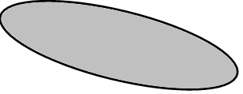
POPULATION (Pie Chart)
Definitions
(using basic Set Theory)
An outcome is the result of an experiment on a population.
Sample Space
The set of all possible outcomes of an experiment.
S = {Red, Orange, Yellow, Green, Blue}.
Venn Diagram
Red
Orange
Yellow
F
Perform repeated trials of the following experiment: Randomly select an individual from the population, and record its color.
E
Green
Blue
Event
Any subset of S (including the empty set ∅, and S itself).
Outcome | Probability
Red | 0.10
Orange | 0.15
Yellow | 0.20
Green | 0.25
Blue | 0.30
 | 1.00
E = “Primary Color”
= {Red, Yellow, Blue}
P(E) = 0.60
F = “Hot Color”
= {Red, Orange, Yellow}
P(F) = 0.45
Complement F ^{C} =
“Not F” =
“Cold Color”
= {Green, Blue}
P(F^{C}) = 1 – P(F) = 0.55
Intersection E ⋂ F =
“E and F” =
{Red, Yellow}
P(E ⋂ F) = 0.3
Note: A = {Red, Green} ⋂ B = {Orange, Blue} =
P(∅) = 0
∅
A and B are disjoint, or mutually exclusive events
Union E ⋃ F =
“E or F“ =
{Red, Orange, Yellow, Blue}
All probs are > 0, and sum = 1.
P(E ⋃ F) =
P(E ⋃ F) = P(E)
P(E ⋃ F) = 0.75

Slide 28
POPULATION (Pie Chart)
Definitions
(using basic Set Theory)
An outcome is the result of an experiment on a population.
Sample Space
The set of all possible outcomes of an experiment.
S = {Red, Orange, Yellow, Green, Blue}.
Venn Diagram
Red
Orange
Yellow
F
Perform repeated trials of the following experiment: Randomly select an individual from the population, and record its color.
E
Green
Blue
Event
Any subset of S (including the empty set ∅, and S itself).
Outcome | Probability
Red | 0.10
Orange | 0.15
Yellow | 0.20
Green | 0.25
Blue | 0.30
 | 1.00
E = “Primary Color”
= {Red, Yellow, Blue}
P(E) = 0.60
F = “Hot Color”
= {Red, Orange, Yellow}
P(F) = 0.45
Complement F ^{C} =
“Not F” =
“Cold Color”
= {Green, Blue}
P(F^{C}) = 1 – P(F) = 0.55
Intersection E ⋂ F =
“E and F” =
{Red, Yellow}
P(E ⋂ F) = 0.3
Note: A = {Red, Green} ⋂ B = {Orange, Blue} =
P(∅) = 0
∅
A and B are disjoint, or mutually exclusive events
Union E ⋃ F =
“E or F“ =
{Red, Orange, Yellow, Blue}
All probs are > 0, and sum = 1.
P(E ⋃ F) = P(E)
P(E ⋃ F) = P(E) + P(F)
P(E ⋃ F) = 0.75

Slide 29
POPULATION (Pie Chart)
Definitions
(using basic Set Theory)
An outcome is the result of an experiment on a population.
Sample Space
The set of all possible outcomes of an experiment.
S = {Red, Orange, Yellow, Green, Blue}.
Venn Diagram
Red
Orange
Yellow
F
Perform repeated trials of the following experiment: Randomly select an individual from the population, and record its color.
E
Green
Blue
Event
Any subset of S (including the empty set ∅, and S itself).
Outcome | Probability
Red | 0.10
Orange | 0.15
Yellow | 0.20
Green | 0.25
Blue | 0.30
 | 1.00
E = “Primary Color”
= {Red, Yellow, Blue}
P(E) = 0.60
F = “Hot Color”
= {Red, Orange, Yellow}
P(F) = 0.45
Complement F ^{C} =
“Not F” =
“Cold Color”
= {Green, Blue}
P(F^{C}) = 1 – P(F) = 0.55
Intersection E ⋂ F =
“E and F” =
{Red, Yellow}
P(E ⋂ F) = 0.3
Note: A = {Red, Green} ⋂ B = {Orange, Blue} =
P(∅) = 0
∅
A and B are disjoint, or mutually exclusive events
Union E ⋃ F =
“E or F“ =
{Red, Orange, Yellow, Blue}
All probs are > 0, and sum = 1.
P(E ⋃ F) = P(E) + P(F)
P(E ⋃ F) = P(E) + P(F) – P(E ⋂ F)
P(E ⋃ F) = 0.75

Slide 30
POPULATION (Pie Chart)
Definitions
(using basic Set Theory)
An outcome is the result of an experiment on a population.
Sample Space
The set of all possible outcomes of an experiment.
S = {Red, Orange, Yellow, Green, Blue}.
Venn Diagram
Red
Orange
Yellow
F
Perform repeated trials of the following experiment: Randomly select an individual from the population, and record its color.
E
Green
Blue
Event
Any subset of S (including the empty set ∅, and S itself).
Outcome | Probability
Red | 0.10
Orange | 0.15
Yellow | 0.20
Green | 0.25
Blue | 0.30
 | 1.00
E = “Primary Color”
= {Red, Yellow, Blue}
P(E) = 0.60
F = “Hot Color”
= {Red, Orange, Yellow}
P(F) = 0.45
Complement F ^{C} =
“Not F” =
“Cold Color”
= {Green, Blue}
P(F^{C}) = 1 – P(F) = 0.55
Intersection E ⋂ F =
“E and F” =
{Red, Yellow}
P(E ⋂ F) = 0.3
Note: A = {Red, Green} ⋂ B = {Orange, Blue} =
P(∅) = 0
∅
A and B are disjoint, or mutually exclusive events
Union E ⋃ F =
“E or F“ =
{Red, Orange, Yellow, Blue}
All probs are > 0, and sum = 1.
P(E ⋃ F) = P(E) + P(F) – P(E ⋂ F)
P(E ⋃ F) = P(E) + P(F) – P(E ⋂ F) = 0.60 + 0.45 – 0.30
P(E ⋃ F) = 0.75

Slide 31
POPULATION (Pie Chart)
Definitions
(using basic Set Theory)
An outcome is the result of an experiment on a population.
Sample Space
The set of all possible outcomes of an experiment.
S = {Red, Orange, Yellow, Green, Blue}.
Venn Diagram
Red
Orange
Yellow
F
Perform repeated trials of the following experiment: Randomly select an individual from the population, and record its color.
E
Green
Blue
Event
Any subset of S (including the empty set ∅, and S itself).
Outcome | Probability
Red | 0.10
Orange | 0.15
Yellow | 0.20
Green | 0.25
Blue | 0.30
 | 1.00
E = “Primary Color”
= {Red, Yellow, Blue}
P(E) = 0.60
F = “Hot Color”
= {Red, Orange, Yellow}
P(F) = 0.45
Complement F ^{C} =
“Not F” =
“Cold Color”
= {Green, Blue}
P(F^{C}) = 1 – P(F) = 0.55
Intersection E ⋂ F =
“E and F” =
{Red, Yellow}
P(E ⋂ F) = 0.3
Note: A = {Red, Green} ⋂ B = {Orange, Blue} =
P(∅) = 0
∅
A and B are disjoint, or mutually exclusive events
Union E ⋃ F =
“E or F“ =
{Red, Orange, Yellow, Blue}
All probs are > 0, and sum = 1.
P(E ⋃ F) = P(E) + P(F) – P(E ⋂ F) = 0.60 + 0.45 – 0.30
P(E ⋃ F) = 0.75

Slide 32
In general, for any two events A and B, there are 4 disjoint intersections:
If events E and F are disjoint,
then P(E ⋂ F) = 0.
So…
A
B
P(E ⋃ F) = P(E) + P(F)
A ⋂ B^{c}
A ⋂ B
A^{c} ⋂ B
F
E
“A only”
“A and B”
“B only”
A^{c} ⋂ B^{c}
“Neither A nor B”
Probability Table
 | B | B^{C}
A | P(A ⋂ B) | P(A⋂ B^{C}) | P(A)
A^{C} | P(A^{C} ⋂ B) | P(A^{C} ⋂ B^{C}) | P(A^{C})
 | P(B) | P(B^{C}) | 1.0
P(E ⋃ F) = P(E) + P(F) – P(E ⋂ F)

Slide 33
POPULATION (Pie Chart)
Definitions
(using basic Set Theory)
An outcome is the result of an experiment on a population.
Sample Space
The set of all possible outcomes of an experiment.
S = {Red, Orange, Yellow, Green, Blue}.
Venn Diagram
Red
Orange
Yellow
F
Perform repeated trials of the following experiment: Randomly select an individual from the population, and record its color.
E
Green
Blue
Event
Any subset of S (including the empty set ∅, and S itself).
Outcome | Probability
Red | 0.10
Orange | 0.15
Yellow | 0.20
Green | 0.25
Blue | 0.30
 | 1.00
E = “Primary Color”
= {Red, Yellow, Blue}
P(E) = 0.60
F = “Hot Color”
= {Red, Orange, Yellow}
P(F) = 0.45
Probability Table
 | E | E^{C}
F | P(E ⋂ F) | P(E^{C} ⋂ F) | P(F)
F^{C} | P(E ⋂ F^{C}) | P(E^{C} ⋂ F^{C}) | P(F^{C})
 | P(E) | P(E^{C}) | 1.0
All probs are > 0, and sum = 1.

Slide 34
POPULATION (Pie Chart)
Definitions
(using basic Set Theory)
An outcome is the result of an experiment on a population.
Sample Space
The set of all possible outcomes of an experiment.
S = {Red, Orange, Yellow, Green, Blue}.
Venn Diagram
Red
Orange
Yellow
F
Perform repeated trials of the following experiment: Randomly select an individual from the population, and record its color.
E
Green
Blue
Event
Any subset of S (including the empty set ∅, and S itself).
Outcome | Probability
Red | 0.10
Orange | 0.15
Yellow | 0.20
Green | 0.25
Blue | 0.30
 | 1.00
E = “Primary Color”
= {Red, Yellow, Blue}
P(E) = 0.60
F = “Hot Color”
= {Red, Orange, Yellow}
P(F) = 0.45
Probability Table
 | E | E^{C}
F | 0.30 | 0.15 | 0.45
F^{C} | 0.30 | 0.25 | 0.55
 | 0.60 | 0.40 | 1.0
All probs are > 0, and sum = 1.

Slide 35
POPULATION (Pie Chart)
Definitions
(using basic Set Theory)
An outcome is the result of an experiment on a population.
Sample Space
The set of all possible outcomes of an experiment.
S = {Red, Orange, Yellow, Green, Blue}.
Venn Diagram
0.15
0.30
F
Perform repeated trials of the following experiment: Randomly select an individual from the population, and record its color.
E
0.25
0.30
Event
Any subset of S (including the empty set ∅, and S itself).
Outcome | Probability
Red | 0.10
Orange | 0.15
Yellow | 0.20
Green | 0.25
Blue | 0.30
 | 1.00
E = “Primary Color”
= {Red, Yellow, Blue}
P(E) = 0.60
F = “Hot Color”
= {Red, Orange, Yellow}
P(F) = 0.45
Probability Table
 | E | E^{C}
F | 0.30 | 0.15 | 0.45
F^{C} | 0.30 | 0.25 | 0.55
 | 0.60 | 0.40 | 1.0
All probs are > 0, and sum = 1.

Slide 36

~ Summary of Basic Properties of Probability ~ Population Hypothesis ⇒ Experiment ⇒ Sample space 𝓢 of possible outcomes ⇒ Event E ⊆ 𝓢 ⇒ Probability P(E) = ?
Def: P(E) = “limiting value” of as experiment is repeated indefinitely.
P(E) = Σ P(outcomes) = always a number between 0 and 1. (That is, 0 ≤ P(E) ≤ 1.)
If AND ONLY IF all outcomes in 𝓢 are equally likely, then P(E) =
If E and F are any two events, then so are the following:
𝓢
Event | Description | Notation | Terminology | Probab
Not E | “E does not occur.” |  | complement of E | 1 – P(E)
E and F | “Both E and F occur simultaneously.” | E ⋂ F | intersection of E and F | -
E or F | “Either E occurs, or F occurs (or both).” | E ⋃ F | union of E and F | P(E) + P(F) – P(E ⋂ F)
E^{C}
E
E F
E F
 | “If E occurs, then F occurs.” | E ⊆ F | E is a subset of F | P(E ⋂ F)
E
F

Slide 37
Example: Two treatments exist for a certain disease, which can either be taken separately or in combination. Suppose:
70% of patient population receives T₁
50% of patient population receives T₂
30% of patient population receives both T₁ and T₂
T₁ T₂
T₁ ⋂ T₂^{c}
T₁^{c} ⋂ T₂
(w/ or w/o T₂)
T₁ ⋂ T₂
(w/ or w/o T₁)
T₁^{c} ⋂ T₂^{c}
P(T₁) = 0.7
0.7
P(T₂) = 0.5
0.5
P(T₁ ⋂ T₂) = 0.3
0.3
0.3
Row marginal sums
What percentage receives T₁ only?
(w/o T₂)
 | T₁ | T₁^{c}
T₂
T₂^{c}
 |  |  | 1.0
P(T₁ ⋂ T₂^{c}) = 0.7 – 0.3 = 0.4…. i.e., 40%
0.4
0.4
What percentage receives T₂ only?
(w/o T₁)
0.5
P(T₁^{c} ⋂ T₂) = 0.5 – 0.3 = 0.2…. i.e., 20%
0.3
0.2
0.2
Column marginal sums
What percentage receives neither T₁ nor T₂?
P(T₁^{c} ⋂ T₂^{c}) = 1 – (0.4 + 0.3 + 0.2) = 0.1…. i.e., 10%
0.1
0.1

Slide 38
In general, for three events A, B, and C…
A
B
A ⋂ B
A ⋂ C
B ⋂ C
C

Slide 39
In general, for three events A, B, and C…
A
B
A ⋂ B
C

Slide 40
In general, for three events A, B, and C…
A
B
A ⋂ B^{c} ⋂ C^{c}
A ⋂ B ⋂ C^{c}
A^{c} ⋂ B ⋂ C^{c}
“A only”
“B only”
A ⋂ B ⋂ C
A ⋂ B^{c} ⋂ C
A^{c} ⋂ B ⋂ C
A^{c} ⋂ B^{c} ⋂ C
A^{c} ⋂ B^{c} ⋂ C^{c}
“C only”
“Neither A nor B nor C”
C

Slide 41
In general, for three events A, B, and C…
A
B
A ⋂ B^{c} ⋂ C^{c}
A ⋂ B ⋂ C^{c}
A^{c} ⋂ B ⋂ C^{c}
“A only”
“B only”

A ⋂ B ⋂ C
A ⋂ B^{c} ⋂ C
A^{c} ⋂ B ⋂ C
A^{c} ⋂ B^{c} ⋂ C
A^{c} ⋂ B^{c} ⋂ C^{c}
“C only”
“Neither A nor B nor C”
“All three events occur”
C

Slide 42
In general, for three events A, B, and C…
A
B

A ⋂ B^{c} ⋂ C^{c}
A ⋂ B ⋂ C^{c}
A^{c} ⋂ B ⋂ C^{c}
“A only”
“B only”
A ⋂ B ⋂ C


A ⋂ B^{c} ⋂ C
A^{c} ⋂ B ⋂ C
A^{c} ⋂ B^{c} ⋂ C
A^{c} ⋂ B^{c} ⋂ C^{c}
“C only”
“Neither A nor B nor C”
“Exactly two events occur”
C

Slide 43
In general, for three events A, B, and C…
A
B

A ⋂ B^{c} ⋂ C^{c}
A ⋂ B ⋂ C^{c}
A^{c} ⋂ B ⋂ C^{c}
“A only”
“B only”

A ⋂ B ⋂ C


A ⋂ B^{c} ⋂ C
A^{c} ⋂ B ⋂ C
A^{c} ⋂ B^{c} ⋂ C
A^{c} ⋂ B^{c} ⋂ C^{c}
“C only”
“Neither A nor B nor C”
“At least two events occur”
C

Slide 44
In general, for three events A, B, and C…
A
B


A ⋂ B^{c} ⋂ C^{c}
A ⋂ B ⋂ C^{c}
A^{c} ⋂ B ⋂ C^{c}
“A only”
“B only”
A ⋂ B ⋂ C
A ⋂ B^{c} ⋂ C
A^{c} ⋂ B ⋂ C

A^{c} ⋂ B^{c} ⋂ C
A^{c} ⋂ B^{c} ⋂ C^{c}
“C only”
“Neither A nor B nor C”
“Exactly one event occurs”
C

Slide 45
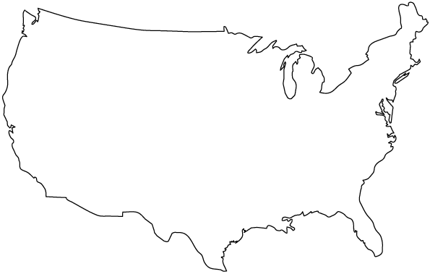

Informal Description of Conditional Probability
A = lung cancer (sub-)population
Probability of lung cancer
P(POPULATION) = 1
POPULATION
P(A) corresponds to the ratio of the probability of A, relative to the entire population.
A
= “Lung Cancer”
B = smoking (sub-)population
A ∩ B
Probability of lung cancer and smoker
P(A ⋂ B) = the probability that both events occur simultaneously in the popul.
B
= “Smoker”

Slide 46
Informal Description of Conditional Probability
A = lung cancer (sub-)population
Probability of lung cancer
P(A) corresponds to the ratio of the probability of A, relative to the entire population.
A
= “Lung Cancer”
B = smoking (sub-)population
A ∩ B
Probability of lung cancer and smoker
P(A ⋂ B) = the probability that both events occur simultaneously in the popul.
B
= “Smoker”
Probability of lung cancer, given smoker
CONDITIONAL PROBABILITY
P(A | B) corresponds to the ratio of the probability of A ∩ B,
relative to the probability of B.
That is,

Slide 47
POPULATION
E = “Primary Color”
= {Red, Yellow, Blue}
P(E) = 0.60
F = “Hot Color”
= {Red, Orange, Yellow}
P(F) = 0.45
Probability of “Primary Color,” given “Hot Color” = ?
Outcome | Probability
Red | 0.10
Orange | 0.15
Yellow | 0.20
Green | 0.25
Blue | 0.30
 | 1.00
Venn Diagram
Orange
F
Red
0.15
0.30
Yellow
E
0.30
Blue
0.25
Green
 | E | E^{C}
F | 0.30 | 0.15 | 0.45
F^{C} | 0.30 | 0.25 | 0.55
 | 0.60 | 0.40 | 1.0
Probability Table

Slide 48
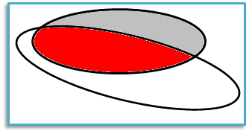
POPULATION
E = “Primary Color”
= {Red, Yellow, Blue}
P(E) = 0.60
F = “Hot Color”
= {Red, Orange, Yellow}
P(F) = 0.45
Conditional Probability
Probability of “Primary Color,” given “Hot Color” = ?
P(E | F)
=
0.667
P(F | E)
Outcome | Probability
Red | 0.10
Orange | 0.15
Yellow | 0.20
Green | 0.25
Blue | 0.30
 | 1.00
F
Venn Diagram
Orange
F
Orange
0.15
Red
0.15
Red
0.30
0.30
Yellow
Yellow
E
E
0.30
0.30
Blue
Blue
0.25
0.25
Green
Green
 | E | E^{C}
F | 0.30 | 0.15 | 0.45
F^{C} | 0.30 | 0.25 | 0.55
 | 0.60 | 0.40 | 1.0
Probability Table

Slide 49
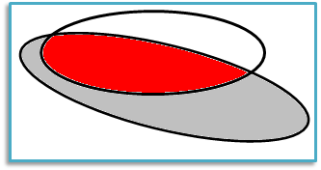
POPULATION
E = “Primary Color”
= {Red, Yellow, Blue}
P(E) = 0.60
F = “Hot Color”
= {Red, Orange, Yellow}
P(F) = 0.45
Conditional Probability
Probability of “Primary Color,” given “Hot Color” = ?
P(E | F)
=
0.667
P(F | E)
0.5
Outcome | Probability
Red | 0.10
Orange | 0.15
Yellow | 0.20
Green | 0.25
Blue | 0.30
 | 1.00
Venn Diagram
Orange
F
Red
0.15
0.30
Yellow
E
0.30
Blue
0.25
Green
 | E | E^{C}
F | 0.30 | 0.15 | 0.45
F^{C} | 0.30 | 0.25 | 0.55
 | 0.60 | 0.40 | 1.0
Probability Table

Slide 50
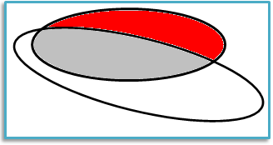
POPULATION
E = “Primary Color”
= {Red, Yellow, Blue}
P(E) = 0.60
F = “Hot Color”
= {Red, Orange, Yellow}
P(F) = 0.45
Conditional Probability
Probability of “Primary Color,” given “Hot Color” = ?
P(E | F)
0.667
P(E^{C} | F)
= 1 – 0.667 = 0.333
P(F | E)
0.5
Outcome | Probability
Red | 0.10
Orange | 0.15
Yellow | 0.20
Green | 0.25
Blue | 0.30
 | 1.00
Venn Diagram
Orange
F
Red
0.15
0.30
Yellow
E
0.30
Blue
0.25
Green
 | E | E^{C}
F | 0.30 | 0.15 | 0.45
F^{C} | 0.30 | 0.25 | 0.55
 | 0.60 | 0.40 | 1.0
Probability Table

Slide 51

POPULATION
E = “Primary Color”
= {Red, Yellow, Blue}
P(E) = 0.60
F = “Hot Color”
= {Red, Orange, Yellow}
P(F) = 0.45
Conditional Probability
Probability of “Primary Color,” given “Hot Color” = ?
P(E | F)
0.667
P(E^{C} | F)
= 1 – 0.667 = 0.333
P(F | E)
0.5
P(E | F^{C})
0.545
Outcome | Probability
Red | 0.10
Orange | 0.15
Yellow | 0.20
Green | 0.25
Blue | 0.30
 | 1.00
Venn Diagram
Orange
F
Red
0.15
Red
0.30
Yellow
Yellow
E
0.30
Blue
0.25
Green
 | E | E^{C}
F | 0.30 | 0.15 | 0.45
F^{C} | 0.30 | 0.25 | 0.55
 | 0.60 | 0.40 | 1.0
Probability Table

Slide 52

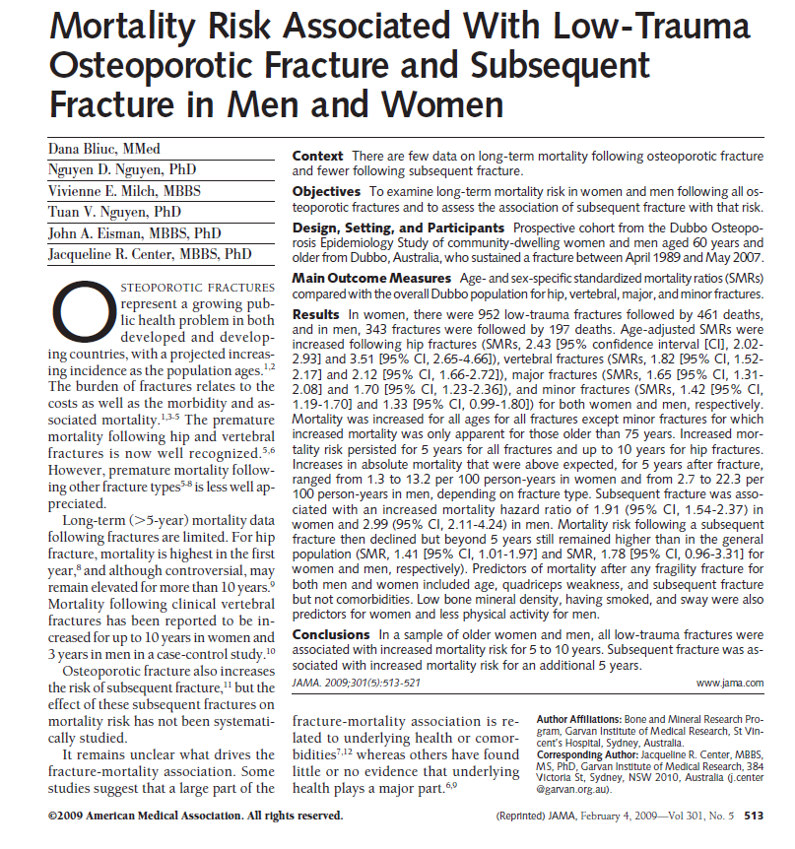
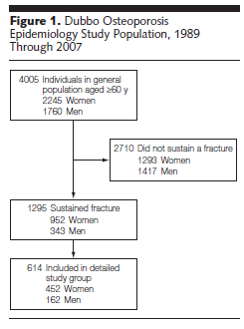
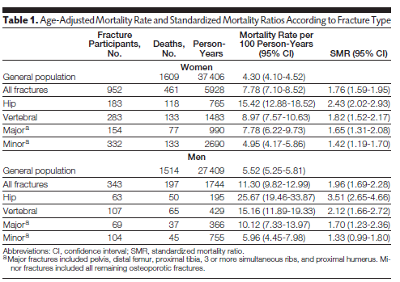
Example:

Slide 53
Women
Fractures
1293
952
343
1417
n = 4005
P(Fracture) ≈
1295 / 4005 = 0.323
P(Fracture and Woman) ≈
 | Women | Men
Fractures | 952 | 343 | 1295
No Fractures | 1293 | 1417 | 2710
 | 2245 | 1760 | 4005
952 / 4005 = 0.238
P(Fracture, given Woman) ≈
952 / 2245 = 0.424
P(Fracture, given Man) ≈
343 / 1760 = 0.195
P(Man, given Fracture) ≈
343 / 1295 = 0.265
P(Woman, given Fracture) =
1 – 343 / 1295 = 952 / 1295 = 0.735

Slide 54


Women
Fractures
1293
952
343
1417
n = 4005
P(Fracture) ≈
1295 / 4005 = 0.323
“Osteoporosis-related fractures are more than twice as likely to occur among women than men.”
P(Fracture and Woman) ≈
952 / 4005 = 0.238
P(Fracture, given Woman) ≈
952 / 2245 = 0.424
“A person who suffers an osteoporosis-related fracture is almost three times more likely to be a woman than a man.”
P(Fracture, given Man) ≈
343 / 1760 = 0.195
P(Man, given Fracture) ≈
343 / 1295 = 0.265
P(Woman, given Fracture) =
1 – 343 / 1295 = 952 / 1295 = 0.735

Slide 55

Women
Fractures
?
?
1293
952
343
?
?
1417
n = 4005
P(Fracture) ≈
1295 / 4005 = 0.323
“Osteoporosis-related fractures are more than twice as likely to occur among women than men.”
P(Fracture and Woman) ≈
952 / 4005 = 0.238
P(Fracture, given Woman) ≈
952 / 2245 = 0.424
“A person who suffers an osteoporosis-related fracture is almost three times more likely to be a woman than a man.”
P(Fracture, given Man) ≈
343 / 1760 = 0.195
P(Man, given Fracture) ≈
343 / 1295 = 0.265
P(Woman, given Fracture) =
1 – 343 / 1295 = 952 / 1295 = 0.735

Slide 56

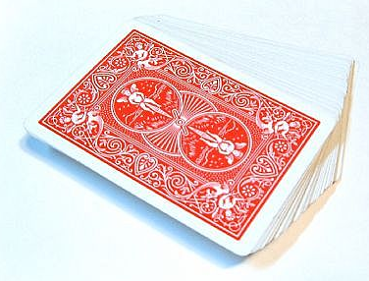
Def: The conditional probability of event A, given event B, is denoted by P(A|B), and calculated via the formula
A
B
Thus, for any two events A and B, it follows that P(A ⋂ B) = P(A | B) × P(B).
B occurs with prob P(B) Given that B occurs, A occurs with prob P(A | B)
Both A and B occur, with prob P(A ⋂ B)
Example: P(Live to 75) × P(Live to 80 | Live to 75) = P(Live to 80)
Example: Randomly select two cards without replacement from a fair deck.
P(Both Aces) = ?
Example: Randomly select two cards with replacement from a fair deck.
P(Both Aces) = ?
P(Ace₁) = 4/52
P(Ace₂ | Ace₁) = 4/52
P(Ace₂ | Ace₁) = 3/51
P(Ace₁ ∩ Ace₂) = (4/52)(3/51)
P(Ace₁ ∩ Ace₂) = (4/52)²
Exercises:
P(Neither is an Ace) = ? P(Exactly one is an Ace) = ? P(At least one is an Ace) = ?

Slide 57
Def: The conditional probability of event A, given event B, is denoted by P(A|B), and calculated via the formula
A
B
Thus, for any two events A and B, it follows that P(A ⋂ B) = P(A | B) × P(B).
B occurs with prob P(B) Given that B occurs, A occurs with prob P(A | B)
Both A and B occur, with prob P(A ⋂ B)
Example: P(Live to 75) × P(Live to 80 | Live to 75) = P(Live to 80)
Tree Diagrams
Multiply together “branch probabilities” to obtain “intersection probabilities”
P(A | B)
P(A ⋂ B)
Event | A | A^{c}
B | P(A ⋂ B) | P(A^{c} ⋂ B)
B^{c} | P(A ⋂ B^{c}) | P(A^{c} ⋂ B^{c})
P(B)
P(A^{c} | B)
P(A^{c} ⋂ B)
P(A | B^{c})
A B
P(B^{c})
P(A ⋂ B^{c})
A ⋂ B^{c}
A ⋂ B
A^{c} ⋂ B
P(A^{c} | B^{c})
P(A^{c} ⋂ B^{c})
A^{c} ⋂ B^{c}

Slide 58
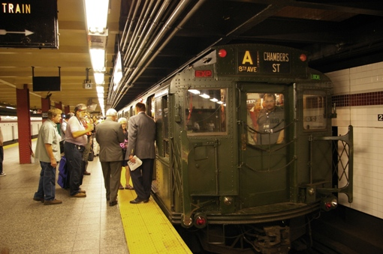
Example:
Bob must take two trains to his home in Manhattan after work: the A and the B, in either order. At 5:00 PM…
The A train arrives first with probability 0.65, and takes 30 mins to reach its last stop at Times Square.
The B train arrives first with probability 0.35, and takes 30 mins to reach its last stop at Grand Central Station.
At Times Square, Bob exits, and catches the second train. The A arrives first with probability 0.4, then travels to Brooklyn. The B train arrives first with probability 0.6, and takes 30 minutes to reach a station near his home.
At Grand Central Station, the A train arrives first with probability 0.8, and takes 30 minutes to reach a station near his home. The B train arrives first with probability 0.2, then travels to Queens.
With what probability will Bob be exiting the subway at 6:00 PM?

Slide 59


Example:
Bob must take two trains to his home in Manhattan after work: the A and the B, in either order. At 5:00 PM…
The A train arrives first with probability 0.65, and takes 30 mins to reach its last stop at Times Square.
The B train arrives first with probability 0.35, and takes 30 mins to reach its last stop at Grand Central Station.
At Times Square, Bob exits, and catches the second train. The A arrives first with probability 0.4, then travels to Brooklyn. The B train arrives first with probability 0.6, and takes 30 minutes to reach a station near his home.
At Grand Central Station, the A train arrives first with probability 0.8, and takes 30 minutes to reach a station near his home. The B train arrives first with probability 0.2, then travels to Queens.
With what probability will Bob be exiting the subway at 6:00 PM?
5:00
5:30
6:00
MULTIPLY:
ADD:
0.4
0.65
0.26
0.6
0.39
0.8
0.67
0.35
0.28
0.2
0.07

Slide 60


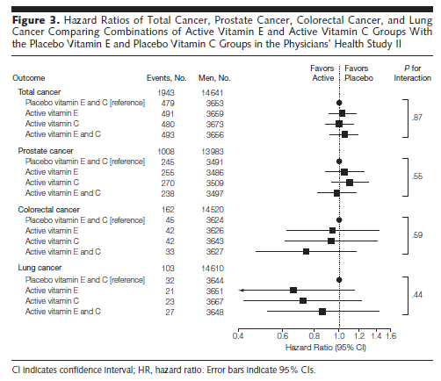
Example:

Slide 61
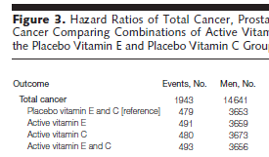
Let events C, D, and E be defined as:
E = Active vitamin E
C = Active vitamin C
D = Disease (Total Cancer)
E
C
Treatment | D + | D – | Totals
Placebo E and C | 479 |  | 3653
E (+ placebo C) | 491 |  | 3659
C (+ placebo E) | 480 |  | 3673
Active E and C | 493 |  | 3656
Totals | 1943 |  | 14641
D –
3174
3168
3193
3163
12698
3163
3168
3193
493
491
480
479
D
3174
P(C) ≈ 7329 / 14641 = 0.5
“balanced”
P(E) ≈ 7315 / 14641 = 0.5
P(D) ≈ 1943 / 14641 = 0.133
These study results suggest that D is statistically independent of both C and E, i.e., no association exists.
P(D, given C) ≈ 973 / 7329 = 0.133
P(D, given E) ≈ 984 / 7315 = 0.135

Slide 62
POPULATION

Slide 63
POPULATION
Outcome | Probability
Red | 0.10
Orange | 0.18
Yellow | 0.17
Green | 0.22
Blue | 0.33
 | 1.00
Venn Diagram
Orange
F
Red
0.18
0.27
Yellow
E
0.33
Blue
0.22
Green
 | E | E^{C}
F | 0.27 | 0.18 | 0.45
F^{C} | 0.33 | 0.22 | 0.55
 | 0.60 | 0.40 | 1.0
Probability Table

Slide 64
POPULATION
E = “Primary Color”
= {Red, Yellow, Blue}
P(E) = 0.60
F = “Hot Color”
= {Red, Orange, Yellow}
P(F) = 0.45
Conditional Probability
P(E | F)
0.60
= P(E)
P(F | E)
0.45
= P(F)
Outcome | Probability
Red | 0.10
Orange | 0.18
Yellow | 0.17
Green | 0.22
Blue | 0.33
 | 1.00
Venn Diagram
Orange
F
Red
0.18
0.27
Yellow
E
0.33
Blue
0.22
Green
 | E | E^{C}
F | 0.27 | 0.18 | 0.45
F^{C} | 0.33 | 0.22 | 0.55
 | 0.60 | 0.40 | 1.0
Probability Table

Slide 65
POPULATION
E = “Primary Color”
= {Red, Yellow, Blue}
P(E) = 0.60
F = “Hot Color”
= {Red, Orange, Yellow}
P(F) = 0.45
Events E and F are “statistically independent”
Conditional Probability
P(E | F) = P(E)
“Primary colors” comprise 60% of the “hot colors,” and 60% of the general population.
P(F | E) = P(F)
“Hot colors” comprise 45% of the “primary colors,” and 45% of the general population.
Outcome | Probability
Red | 0.10
Orange | 0.18
Yellow | 0.17
Green | 0.22
Blue | 0.33
 | 1.00
Venn Diagram
Orange
F
Red
0.18
0.27
Yellow
E
0.33
Blue
0.22
Green
 | E | E^{C}
F | 0.27 | 0.18 | 0.45
F^{C} | 0.33 | 0.22 | 0.55
 | 0.60 | 0.40 | 1.0
Probability Table

Slide 66
Def: Two events A and B are said to be statistically independent if
P(A | B) = P(A),
Neither event provides any information about the other.
which is equivalent to
P(A ⋂ B) = P(A | B) × P(B).
P(A)
If either of these two conditions fails, then A and B are statistically dependent.
B occurs with prob P(B) Given that B occurs, A occurs with prob P(A | B)
Both A and B occur, with prob P(A ⋂ B)
P(A)
Example: Are events A = “Ace” and B = “Black” statistically independent?
P(A) = 4/52 = 1/13, P(B) = 26/52 = 1/2, P(A ⋂ B) = 2/52 = 1/26 YES!
Example:
E = “Primary Color” = {Red, Yellow, Blue}
F = “Hot Color” = {Red, Orange, Yellow}
 | E | E^{C}
F | 0.27 | 0.18 | 0.45
F^{C} | 0.33 | 0.22 | 0.55
 | 0.60 | 0.40 | 1.0
Outcome | Probability
Red | 0.10
Orange | 0.18
Yellow | 0.17
Green | 0.22
Blue | 0.33
 | 1.00
P(F) =
P(E ⋂ F) = P(E) P(F)?
Is 0.27 = 0.60 × 0.45?
= P(E)
YES!
Events E and F are “statistically independent” 

Slide 67
Def: Two events A and B are said to be statistically independent if
P(A | B) = P(A),
Neither event provides any information about the other.
which is equivalent to
P(A ⋂ B) = P(A | B) × P(B).
P(A)
If either of these two conditions fails, then A and B are statistically dependent.
Example: According to the American Red Cross, US pop is distributed as shown.
 | Rh Factor
Blood Type | + | – | Row marginals:
O | .384 | .077 | .461
A | .323 | .065 | .388
B | .094 | .017 | .111
AB | .032 | .007 | .039
Column marginals: | .833 | .166 | .999
Are “Type O” and “Rh+” statistically independent?
= P(O)
P(O ⋂ Rh+) = .384
Is .384 = .461 × .833?
YES!
= P(Rh+)

Slide 68
IMPORTANT FORMULAS
P(A^{c}) = 1 – P(A)
P(A ⋃ B) = P(A) + P(B) – P(A ⋂ B)
= 0 if A and B are disjoint
A
B
P(A ⋂ B) = P(A | B) P(B)
A and B are statistically independent if:
P(A | B) = P(A)
P(A ⋂ B) = P(A) P(B)
Others…
DeMorgan’s Laws
(A ⋃ B)^{c} = A^{c} ⋂ B^{c}
(A ⋂ B)^{c} = A^{c} ⋃ B^{c}
Distributive Laws
A ⋂ (B ⋃ C) = (A ⋂ B) ⋃ (A ⋂ C)
A ⋃ (B ⋂ C) = (A ⋃ B) ⋂ (A ⋃ C)

Slide 69
Example: In a population of individuals:
60% of adults are male
P(B | A) = 0.6
40% of males are adults
P(A | B) = 0.4
30% are men
P(A ⋂ B) = 0.3
A = Adult B = Male
Women
Men
Boys
0.3
Girls
What percentage are adults?
What percentage are males?
Are “adult” and “male” statistically independent in this population?

Slide 70
Example: In a population of individuals:
60% of adults are male
P(B | A) = 0.6
40% of males are adults
P(A | B) = 0.4
30% are men
P(A ⋂ B) = 0.3
A = Adult B = Male
Women
Men
Boys
⟹ P(B ⋂ A) = 0.6 P(A)
0.3
0.2
0.3
0.45
⟹ P(A ⋂ B) = 0.4 P(B)
Girls
0.3
0.05
0.5 – 0.3 = …
0.75 – 0.3 = …
 | Adult | Child
Male | 0.30 | 0.45 | 0.75
Female | 0.20 | 0.05 | 0.25
 | 0.50 | 0.50 | 1.00
What percentage are adults?
P(A) = 0.3 / 0.6
P(A) = 0.3 / 0.6 = 0.5, or 50%
What percentage are males?
P(B) = 0.3 / 0.4
P(B) = 0.3 / 0.4 = 0.75, or 75%
Are “adult” and “male” statistically independent in this population?
P(A | B) = P(A)? OR P(B | A) = P(B)? OR P(A ⋂ B) = P(A) P(B)?

Slide 71
Example: In a population of individuals:
60% of adults are male
P(B | A) = 0.6
40% of males are adults
P(A | B) = 0.4
30% are men
P(A ⋂ B) = 0.3
A = Adult B = Male
Women
Men
Boys
⟹ P(B ⋂ A) = 0.6 P(A)
0.3
0.2
0.3
0.45
⟹ P(A ⋂ B) = 0.4 P(B)
Girls
0.3
0.05
 | Adult | Child
Male | 0.30 | 0.45 | 0.75
Female | 0.20 | 0.05 | 0.25
 | 0.50 | 0.50 | 1.00
What percentage are adults?
P(A) = 0.3 / 0.6
P(A) = 0.3 / 0.6 = 0.5, or 50%
What percentage are males?
P(B) = 0.3 / 0.4
P(B) = 0.3 / 0.4 = 0.75, or 75%
Are “adult” and “male” statistically independent in this population?
NO
P(A | B) = P(A)? OR P(B | A) = P(B)? OR P(A ⋂ B) = P(A) P(B)?
0.4 ≠ 0.5
0.6 ≠ 0.75
0.3 ≠ (0.5)(0.75)

Slide 72
P(A | B) = 0.4
A = Adult B = Male
60%
Women
Men
Boys
What percentage of males are boys?
0.2
0.3
0.45
P(A^{C} | B) =
0.6
Girls
- OR -
0.05
P(A^{C} | B) = 1 – P(A | B)
= 1 – 0.4 = 0.6
What percentage of females are women?
 | Adult | Child
Male | 0.30 | 0.45 | 0.75
Female | 0.20 | 0.05 | 0.25
 | 0.50 | 0.50 | 1.00
P(A | B^{C}) =
0.8
80%
What percentage of children are girls?
P(B^{C} | A^{C}) =
0.1
10%

Slide 73
Example: In a population of individuals:
60% of adults are male
P(B | A) = 0.6 ⟹
40% of males are adults
P(A | B) = 0.4
A = Adult B = Male
Women
Men
Boys
P(B ⋂ A) = 0.6 P(A)
0.2
0.3
0.45
⟹ P(A ⋂ B) = 0.4 P(B)
Girls
0.05
30% are men
5% are girls
⟹ 95% are not girls
P(A ⋃ B) = 0.95
0.4 P(B) = 0.6 P(A)
P(A ⋃ B) = P(A) + P(B) − P(A ⋂ B)
P(B) = 1.5 P(A)
0.95
0.95 = P(A) + 1.5 P(A) −
0.6 P(A)
0.95 = 1.9 P(A)
⟹ P(A) = 0.95 / 1.9
What percentage are adults?
P(A) = 0.5, i.e., 50%
What percentage are males?
P(B) = 0.75, i.e., 75%
What percentage are men?
P(A ⋂ B) = 0.3, i.e., 30%

Slide 74
Bayes’ Formula
Exactly how does one event A affect the probability of another event B?
P(B)
P(B)
P(B )
A
prior probability
posterior probability
P(B ∩ A)
P(A)
???
Recall……
P(A | B) P(B)
P(A)

Slide 75
Bayes’ Formula
Exactly how does one event A affect the probability of another event B?
P(B)
P(B)
P(B )
A
prior probability
posterior probability
Recall……
P(B | A) =
P(A | B) P(B)
P(A)
Bayes’ Law (short form)

Slide 76
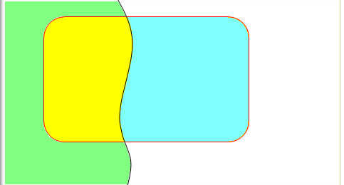
Bayes’ Law (full form, n = 2)
Bayes’ Law (short form)
P(B | A) =
P(A | B) P(B)
P(A)
???
Recall…
“LAW OF TOTAL PROBABILITY”
Also recall……
For any two events A and B, there are 4 disjoint intersections:
B
B^{c}
Probability Table
 | B | B^{C}
A | P(A ⋂ B) | P(A⋂ B^{C}) | P(A)
A^{C} | P(A^{C} ⋂ B) | P(A^{C} ⋂ B^{C}) | P(A^{C})
 | P(B) | P(B^{C}) | 1.0
A
A ⋂ B
A ⋂ B^{c}
“A and B”
“A only”
A^{c} ⋂ B
A^{c} ⋂ B^{c}
“B only”
“Neither A nor B”

Slide 77
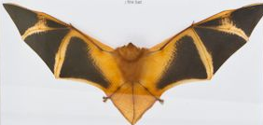
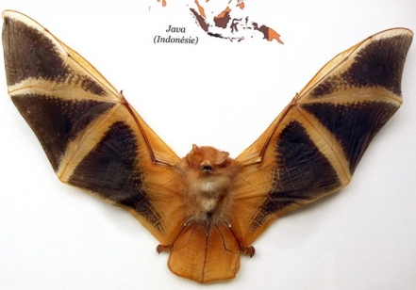
Bayes’ Law (full form, n = 2)
Example:
Two similar bat species, B₁ and B₂, occupy both highland (A) and lowland (A^{c}) areas.
Species B₁ makes up 90% of the population; species B₂, 10%.
20% of spec B₁ live in the highlands, 80% in the lowlands.
60% of spec B₂ live in the highlands, 40% in the lowlands.
What is the probability that a randomly caught bat belongs to each species, if it is caught in the highlands? In the lowlands?
prior probabilities
P(B₁) = .9, P(B₂) = .1
P(A|B₁) = .2, P(A^{c}|B₁) = .8
P(A|B₂) = .6, P(A^{c}|B₂) = .4
posterior probabilities
 | B₁ | B₂ (= B₁^{c})
A
A^{c}
 | .90 | .10 | 1
P(A)
“LAW OF TOTAL PROBABILITY”

Slide 78
Bayes’ Law (full form, n = 2)
Example:
Two similar bat species, B₁ and B₂, occupy both highland (A) and lowland (A^{c}) areas.
Species B₁ makes up 90% of the population; species B₂, 10%.
20% of spec B₁ live in the highlands, 80% in the lowlands.
60% of spec B₂ live in the highlands, 40% in the lowlands.
What is the probability that a randomly caught bat belongs to each species, if it is caught in the highlands? In the lowlands?
prior probabilities
P(B₁) = .9, P(B₂) = .1
P(B₁) = .9, P(B₂) = .1
P(A|B₁) = .2, P(A^{c}|B₁) = .8
P(A|B₁) = .2, P(A^{c}|B₁) = .8
P(A|B₂) = .6, P(A^{c}|B₂) = .4
P(A|B₂) = .6, P(A^{c}|B₂) = .4
posterior probabilities
 | B₁ | B₂ (= B₁^{c})
A
A^{c}
 | .90 | .10 | 1
P(A)
“LAW OF TOTAL PROBABILITY”

Slide 79
Bayes’ Law (full form, n = 2)
Example:
Two similar bat species, B₁ and B₂, occupy both highland (A) and lowland (A^{c}) areas.
Species B₁ makes up 90% of the population; species B₂, 10%.
20% of spec B₁ live in the highlands, 80% in the lowlands.
60% of spec B₂ live in the highlands, 40% in the lowlands.
What is the probability that a randomly caught bat belongs to each species, if it is caught in the highlands? In the lowlands?
prior probabilities
P(B₁) = .9, P(B₂) = .1
P(B₁) = .9, P(B₂) = .1
P(A|B₁) = .2, P(A^{c}|B₁) = .8
P(A|B₁) = .2, P(A^{c}|B₁) = .8
P(A|B₂) = .6, P(A^{c}|B₂) = .4
P(A|B₂) = .6, P(A^{c}|B₂) = .4
posterior probabilities
 | B₁ | B₂ (= B₁^{c})
A | (.2)(.9) | (.6)(.1)
A^{c}
 | .90 | .10 | 1
P(A)
“LAW OF TOTAL PROBABILITY”

Slide 80
Bayes’ Law (full form, n = 2)
Example:
Two similar bat species, B₁ and B₂, occupy both highland (A) and lowland (A^{c}) areas.
Species B₁ makes up 90% of the population; species B₂, 10%.
20% of spec B₁ live in the highlands, 80% in the lowlands.
60% of spec B₂ live in the highlands, 40% in the lowlands.
What is the probability that a randomly caught bat belongs to each species, if it is caught in the highlands? In the lowlands?
prior probabilities
P(B₁) = .9, P(B₂) = .1
P(B₁) = .9, P(B₂) = .1
P(A|B₁) = .2, P(A^{c}|B₁) = .8
P(A|B₁) = .2, P(A^{c}|B₁) = .8
P(A|B₂) = .6, P(A^{c}|B₂) = .4
P(A|B₂) = .6, P(A^{c}|B₂) = .4
posterior probabilities
 | B₁ | B₂ (= B₁^{c})
A | .18 | .06
A^{c}
 | .90 | .10 | 1
P(A)
“LAW OF TOTAL PROBABILITY”

Slide 81
Bayes’ Law (full form, n = 2)
Example:
Two similar bat species, B₁ and B₂, occupy both highland (A) and lowland (A^{c}) areas.
Species B₁ makes up 90% of the population; species B₂, 10%.
20% of spec B₁ live in the highlands, 80% in the lowlands.
60% of spec B₂ live in the highlands, 40% in the lowlands.
What is the probability that a randomly caught bat belongs to each species, if it is caught in the highlands? In the lowlands?
prior probabilities
P(B₁) = .9, P(B₂) = .1
P(B₁) = .9, P(B₂) = .1
P(A|B₁) = .2, P(A^{c}|B₁) = .8
P(A|B₁) = .2, P(A^{c}|B₁) = .8
P(A|B₂) = .6, P(A^{c}|B₂) = .4
P(A|B₂) = .6, P(A^{c}|B₂) = .4
posterior probabilities
 | B₁ | B₂ (= B₁^{c})
A | .18 | .06 | .24
A^{c}
 | .90 | .10 | 1
P(A)
“LAW OF TOTAL PROBABILITY”

Slide 82
Bayes’ Law (full form, n = 2)
Example:
Two similar bat species, B₁ and B₂, occupy both highland (A) and lowland (A^{c}) areas.
Species B₁ makes up 90% of the population; species B₂, 10%.
20% of spec B₁ live in the highlands, 80% in the lowlands.
60% of spec B₂ live in the highlands, 40% in the lowlands.
What is the probability that a randomly caught bat belongs to each species, if it is caught in the highlands? In the lowlands?
prior probabilities
P(B₁) = .9, P(B₂) = .1
P(B₁) = .9, P(B₂) = .1
P(A|B₁) = .2, P(A^{c}|B₁) = .8
P(A|B₁) = .2, P(A^{c}|B₁) = .8
P(A|B₂) = .6, P(A^{c}|B₂) = .4
P(A|B₂) = .6, P(A^{c}|B₂) = .4
posterior probabilities
 | B₁ | B₂ (= B₁^{c})
A | .18 | .06 | .24
A^{c}
 | .90 | .10 | 1
In the highlands…
B₁ decreases from a prior of 90% to a posterior of 75%
B₂ increases from a prior of 10% to a posterior of 25%

Slide 83
Bayes’ Law (full form, n = 2)
Example:
Two similar bat species, B₁ and B₂, occupy both highland (A) and lowland (A^{c}) areas.
Species B₁ makes up 90% of the population; species B₂, 10%.
20% of spec B₁ live in the highlands, 80% in the lowlands.
60% of spec B₂ live in the highlands, 40% in the lowlands.
What is the probability that a randomly caught bat belongs to each species, if it is caught in the highlands? In the lowlands?
prior probabilities
P(B₁) = .9, P(B₂) = .1
P(B₁) = .9, P(B₂) = .1
P(A|B₁) = .2, P(A^{c}|B₁) = .8
P(A|B₁) = .2, P(A^{c}|B₁) = .8
P(A|B₂) = .6, P(A^{c}|B₂) = .4
P(A|B₂) = .6, P(A^{c}|B₂) = .4
posterior probabilities
 | B₁ | B₂ (= B₁^{c})
A | .18 | .06 | .24
A^{c} | .72 | .04 | .76
 | .90 | .10 | 1
In the lowlands…
B₁ increases from a prior of 90% to a posterior of 94.7%
B₂ decreases from a prior of 10% to a posterior of 5.3%

Slide 84
Bayes’ Law (full form, n = 2)
Example:
Two similar bat species, B₁ and B₂, occupy both highland (A) and lowland (A^{c}) areas.
Species B₁ makes up 90% of the population; species B₂, 10%.
20% of spec B₁ live in the highlands, 80% in the lowlands.
60% of spec B₂ live in the highlands, 40% in the lowlands.
What is the probability that a randomly caught bat belongs to each species, if it is caught in the highlands? In the lowlands?
prior probabilities
P(B₁) = .9, P(B₂) = .1
P(B₁) = .9, P(B₂) = .1
P(A|B₁) = .2, P(A^{c}|B₁) = .8
P(A|B₁) = .2, P(A^{c}|B₁) = .8
P(A|B₂) = .6, P(A^{c}|B₂) = .4
P(A|B₂) = .6, P(A^{c}|B₂) = .4
posterior probabilities
Exercise:
Species B₁ – with a prior prob of ??? –
??? to a posterior of ??? in the highlands
??? to a posterior of ??? in the lowlands.
Species B₂ – with a prior prob of ??? –
??? to a posterior of ??? in the highlands
??? to a posterior of ??? in the lowlands.

Slide 85
Example: Vitamin B-complex deficiency among general population
Assume B₁, B₂, B₃, B₄ “partition” the population, i.e., they are disjoint and exhaustive.
Thiamine
Riboflavin
Niacin
No B deficiency
B₁
B₂
B₃
B₄
Given:
“10% of pop is B₁-deficient (only), 20% is B₂-deficient (only), and 30% is B₃-deficient (only). The remaining 40% is not B-deficient.”

Slide 86
Example: Vitamin B-complex deficiency among general population
Assume B₁, B₂, B₃, B₄ “partition” the population, i.e., they are disjoint and exhaustive.
Thiamine
Riboflavin
Niacin
No B deficiency
B₁
B₂
B₃
B₄
A = Alcoholic
P(A ∩ B₁)
P(A ∩ B₂)
P(A ∩ B₃)
P(A ∩ B₄)
A^{c} = Not Alcoholic
P(A^{c} ∩ B₁)
P(A^{c} ∩ B₂)
P(A^{c} ∩ B₃)
P(A^{c} ∩ B₄)
Given:
Prior probs
P(B₁) = .10
P(B₂) = .20
P(B₃) = .30
P(B₄) = .40
1.00
To find these intersection probabilities, we need more information!

Slide 87
Example: Vitamin B-complex deficiency among general population
Assume B₁, B₂, B₃, B₄ “partition” the population, i.e., they are disjoint and exhaustive.
Thiamine
Riboflavin
Niacin
No B deficiency
B₁
B₂
B₃
B₄
A = Alcoholic
P(A ∩ B₁)
P(A ∩ B₂)
P(A ∩ B₃)
P(A ∩ B₄)
A^{c} = Not Alcoholic
P(A^{c} ∩ B₁)
P(A^{c} ∩ B₂)
P(A^{c} ∩ B₃)
P(A^{c} ∩ B₄)
Given:
Prior probs
P(B₁) = .10
P(B₂) = .20
P(B₃) = .30
P(B₄) = .40
1.00
Also
given…
“Alcoholics comprise 35%, 30%, 25%, and 20% of the B₁, B₂, B₃, B₄ groups, respectively.”

Slide 88
Example: Vitamin B-complex deficiency among general population
Assume B₁, B₂, B₃, B₄ “partition” the population, i.e., they are disjoint and exhaustive.
Thiamine
Riboflavin
Niacin
No B deficiency
B₁
B₂
B₃
B₄
A = Alcoholic
P(A ∩ B₁)
P(A ∩ B₂)
P(A ∩ B₃)
P(A ∩ B₄)
A^{c} = Not Alcoholic
P(A^{c} ∩ B₁)
P(A^{c} ∩ B₂)
P(A^{c} ∩ B₃)
P(A^{c} ∩ B₄)
Given:
Prior probs
P(B₁) = .10
P(B₂) = .20
P(B₃) = .30
P(B₄) = .40
1.00
Also
given…
P(A | B₁) = .35
P(A | B₂) = .30
P(A | B₃) = .25
P(A | B₄) = .20

Slide 89
Example: Vitamin B-complex deficiency among general population
Assume B₁, B₂, B₃, B₄ “partition” the population, i.e., they are disjoint and exhaustive.
Thiamine
Riboflavin
Niacin
No B deficiency
B₁
B₂
B₃
B₄
A = Alcoholic
P(A ∩ B₁)
P(A ∩ B₂)
P(A ∩ B₃)
P(A ∩ B₄)
A^{c} = Not Alcoholic
P(A^{c} ∩ B₁)
P(A^{c} ∩ B₂)
P(A^{c} ∩ B₃)
P(A^{c} ∩ B₄)
Given:
Prior probs
P(B₁) = .10
P(B₂) = .20
P(B₃) = .30
P(B₄) = .40
1.00
Also
given…
P(A | B₁) = .35
P(A | B₂) = .30
P(A | B₃) = .25
P(A | B₄) = .20
Recall:
P(A ∩ B) = P(A | B) P(B)

Slide 90
Example: Vitamin B-complex deficiency among general population
Assume B₁, B₂, B₃, B₄ “partition” the population, i.e., they are disjoint and exhaustive.
Thiamine
Riboflavin
Niacin
No B deficiency
B₁
B₂
B₃
B₄
A = Alcoholic
.10 × .35
.035
.20 × .30
.060
.30 × .25
.075
.40 × .20
.080
A^{c} = Not Alcoholic
P(A^{c} ∩ B₁)
P(A^{c} ∩ B₂)
P(A^{c} ∩ B₃)
P(A^{c} ∩ B₄)
Given:
Prior probs
P(B₁) = .10
P(B₂) = .20
P(B₃) = .30
P(B₄) = .40
1.00
Also
given…
P(A | B₁) = .35
P(A | B₂) = .30
P(A | B₃) = .25
P(A | B₄) = .20
Recall:
P(A ∩ B) = P(A | B) P(B)

Slide 91
Example: Vitamin B-complex deficiency among general population
Assume B₁, B₂, B₃, B₄ “partition” the population, i.e., they are disjoint and exhaustive.
Thiamine
Riboflavin
Niacin
No B deficiency
B₁
B₂
B₃
B₄
A = Alcoholic
.10 × .35
.035
.20 × .30
.060
.30 × .25
.075
.40 × .20
.080
A^{c} = Not Alcoholic
.065
.140
.225
.320
Given:
Prior probs
P(B₁) = .10
P(B₂) = .20
P(B₃) = .30
P(B₄) = .40
1.00
Posterior probabilities
P(B₁ | A) = ?
P(B₂ | A) = ?
P(B₃ | A) = ?
P(B₄ | A) = ?

Slide 92
Example: Vitamin B-complex deficiency among general population
Assume B₁, B₂, B₃, B₄ “partition” the population, i.e., they are disjoint and exhaustive.
Thiamine
Riboflavin
Niacin
No B deficiency
B₁
B₂
B₃
B₄
A = Alcoholic
.035
.060
.075
.080
P(A) = .25
.035
A^{c} = Not Alcoholic
.065
.140
.225
.320
P(A^{c}) = .75
Given:
Prior probs
P(B₁) = .10
P(B₂) = .20
P(B₃) = .30
P(B₄) = .40
1.00
Posterior probabilities
P(B₁ ∩ A)
P(A)
P(B₁ | A) = ?
P(B₂ | A) = ?
P(B₃ | A) = ?
P(B₄ | A) = ?

Slide 93
Example: Vitamin B-complex deficiency among general population
Assume B₁, B₂, B₃, B₄ “partition” the population, i.e., they are disjoint and exhaustive.
Thiamine
Riboflavin
Niacin
No B deficiency
B₁
B₂
B₃
B₄
A = Alcoholic
.035
.060
P(A) = .25
.035
.060
.075
.080
.075
.080
A^{c} = Not Alcoholic
.065
.140
.225
.320
P(A^{c}) = .75
Given:
Prior probs
P(B₁) = .10
P(B₂) = .20
P(B₃) = .30
P(B₄) = .40
1.00
Posterior probabilities
P(B₁ | A) =
P(B₂ | A) =
P(B₃ | A) =
P(B₄ | A) =

Slide 94
Example: Vitamin B-complex deficiency among general population
Assume B₁, B₂, B₃, B₄ “partition” the population, i.e., they are disjoint and exhaustive.
Thiamine
Riboflavin
Niacin
No B deficiency
B₁
B₂
B₃
B₄
A = Alcoholic
.035
.060
.075
.080
P(A) = .25
A^{c} = Not Alcoholic
.065
.140
.225
.320
P(A^{c}) = .75
Given:
Prior probs
P(B₁) = .10
P(B₂) = .20
P(B₃) = .30
P(B₄) = .40
1.00
NO CHANGE;
A and B₃ are independent!
INCREASE
INCREASE
DECREASE
Posterior probabilities
P(B₁ | A) = .14
P(B₂ | A) = .24
P(B₃ | A) = .30
P(B₄ | A) = .32

Slide 95
Example: Vitamin B-complex deficiency among general population
Assume B₁, B₂, B₃, B₄ “partition” the population, i.e., they are disjoint and exhaustive.
Thiamine
Riboflavin
Niacin
No B deficiency
B₁
B₂
B₃
B₄
A = Alcoholic
.035
.060
.075
.080
P(A) = .25
A^{c} = Not Alcoholic
.065
.140
.225
.320
P(A^{c}) = .75
Given:
Prior probs
P(B₁) = .10
P(B₂) = .20
P(B₃) = .30
P(B₄) = .40
1.00
Posterior probabilities
Exercise:
P(B₁ | A^{c}) = ??
P(B₂ | A^{c}) = ??
P(B₃ | A^{c}) = ??
P(B₄ | A^{c}) = ??

Slide 96
Example: Vitamin B-complex deficiency among general population
Assume B₁, B₂, B₃, B₄ “partition” the population, i.e., they are disjoint and exhaustive.
Thiamine-deficient
Riboflavin-deficient
C₂
C₅
C₆
C₁
C₄
C₃
Non-deficient
C₈
C₇
Niacin-deficient
C₁ C₂ C₃ C₄ C₅ C₆ C₇ C₈
Alcoholic
A (Yes)
etc.
A^{c} (No)

Slide 97
BAYES’ FORMULA
Assume B₁, B₂, …, B_{n} “partition” the population, i.e., they are disjoint and exhaustive.
B₁ B₂ B₃ ……etc……. B_{n}
A
A^{c}
P(A ∩ B₁)
P(A ∩ B₂)
P(A ∩ B₃)
……etc…….
P(A ∩ B_{n})
P(A)
Given…
P(A^{c} ∩ B₁)
P(A^{c} ∩B₂)
P(A^{c} ∩ B₃)
……etc…….
P(A^{c} ∩ B_{n})
P(A^{c})
Prior probabilities:
P(B₁) P(B₂) P(B₃) ……etc……. P(B_{n})
1
Conditional probabilities:
P(A|B₁) P(A|B₂) P(A|B₃) ……etc……. P(A|B_{n})
Then…
Posterior probabilities:
P(B₁|A) P(B₂|A) P(B₃|A) ……etc……. P(B_{n}|A) are computed via
P(B_{i} ∩ A)
P(A)
P(A | B_{i}) P(B_{i})
P(A | B₁) P(B₁) + P(A | B₂) P(B₂) + …+ P(A | B_{n}) P(B_{n})
P(B_{i} | A) =
=
P(A) = P(A | B₁) P(B₁) + P(A | B₂) P(B₂) + …+ P(A | B_{n}) P(B_{n})
for i = 1, 2, 3,…, n
“LAW OF TOTAL PROBABILITY”

Slide 98
BAYES’ FORMULA
Assume B₁, B₂, …, B_{n} “partition” the population, i.e., they are disjoint and exhaustive.
B₁ B₂ B₃ ……etc……. B_{n}
A
A^{c}
P(A ∩ B₁)
P(A ∩ B₂)
P(A ∩ B₃)
……etc…….
P(A ∩ B_{n})
P(A)
Given…
P(A^{c} ∩ B₁)
P(A^{c} ∩B₂)
P(A^{c} ∩ B₃)
……etc…….
P(A^{c} ∩ B_{n})
P(A^{c})
Prior probabilities:
P(B₁) P(B₂) P(B₃) ……etc……. P(B_{n})
1
?
?
?
?
……etc……
INTERPRET!
Then…
Posterior probabilities:
P(B₁|A) P(B₂|A) P(B₃|A) ……etc……. P(B_{n}|A) are computed via
P(B_{i} ∩ A)
P(A)
P(A | B_{i}) P(B_{i})
P(A | B₁) P(B₁) + P(A | B₂) P(B₂) + …+ P(A | B_{n}) P(B_{n})
P(B_{i} | A) =
=
for i = 1, 2, 3,…, n

Slide 99
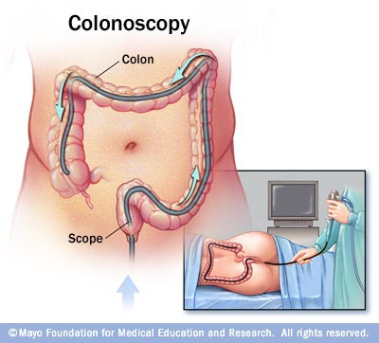
Example: Screening Tests: D = Disease (+ or –), T = Test (+ or –)
“prevalence”
prior probabilities
P(D+) = .10
P(D–) = .90
T–
T+
Ex: Colorectal Cancer
T+ ∩ D+
T+ ∩ D–
Gold Standard
T– ∩ D+
T– ∩ D–
True Positive rate,
“sensitivity”
P(T+ | D+) = .85
False Positive rate
P(T+ | D–) = .02
True Negative rate,
“specificity”
P(T– | D–) = .98
Highly sensitive and highly specific, but expensive. Cost-effective for adults 50+
False Negative rate
P(T– | D+) = .15

Slide 100
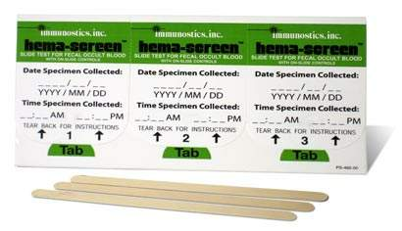
Example: Screening Tests: D = Disease (+ or –), T = Test (+ or –)
“prevalence”
prior probabilities
P(D+) = .10
P(D–) = .90
T–
T+
Ex: Colorectal Cancer
T+ ∩ D+
T+ ∩ D–
T– ∩ D+
T– ∩ D–
True Positive rate,
“sensitivity”
P(T+ | D+) = .85
True Positive rate,
“sensitivity”
P(T+ | D+) = ???
False Positive rate
P(T+ | D–) = .02
False Positive rate
P(T+ | D–) = ???
True Negative rate,
“specificity”
P(T– | D–) = .98
True Negative rate,
“specificity”
P(T– | D–) = ???
False Negative rate
P(T– | D+) = .15
Highly sensitive and highly specific, but expensive. Cost-effective for adults 50+
False Negative rate
P(T– | D+) = ???
Fecal Occult Blood Test (FOBT)
Cheap, fast, easy
(… but disgusting)

Slide 101








Example: Screening Tests: D = Disease (+ or –), T = Test (+ or –)
“prevalence”
prior probabilities
P(D+) = .10
P(D–) = .90
T–
T+
 | D+ | D–
T+ | 114 | 36 | 150
T– | 6 | 44 | 50
 | 120 | 80 | 200
 | D+ | D–
T+ | .57 | .18 | .75
T– | .03 | .22 | .25
 | .60 | .40 | 1
Ex: Colorectal Cancer
T+ ∩ D+
T+ ∩ D–
T– ∩ D+
T– ∩ D–
First determine D± via gold standard on a clinical sample…
True Positive rate,
“sensitivity”
P(T+ | D+) = ???
False Positive rate
P(T+ | D–) = ???
True Negative rate,
“specificity”
P(T– | D–) = ???
Highly sensitive and highly specific, but expensive. Cost-effective for adults 50+
False Negative rate
P(T– | D+) = ???
Fecal Occult Blood Test (FOBT)
Cheap, fast, easy
(… but disgusting)

Slide 102
Example: Screening Tests: D = Disease (+ or –), T = Test (+ or –)
“prevalence”
prior probabilities
P(D+) = .10
P(D–) = .90
T–
T+
 | D+ | D–
T+ | .57 | .18 | .75
T– | .03 | .22 | .25
 | .60 | .40 | 1
Ex: Colorectal Cancer
T+ ∩ D+
T+ ∩ D–
T– ∩ D+
T– ∩ D–
First determine D± via gold standard on a clinical sample…
True Positive rate,
“sensitivity”
P(T+ | D+) = ???
False Positive rate
P(T+ | D–) = ???
True Negative rate,
“specificity”
P(T– | D–) = ???
Highly sensitive and highly specific, but expensive. Cost-effective for adults 50+
False Negative rate
P(T– | D+) = ???
Fecal Occult Blood Test (FOBT)
Cheap, fast, easy
(… but disgusting)

Slide 103
Example: Screening Tests: D = Disease (+ or –), T = Test (+ or –)
“prevalence”
prior probabilities
P(D+) = .10
P(D–) = .90
T–
T+
 | D+ | D–
T+ | .57 | .18 | .75
T– | .03 | .22 | .25
 | .60 | .40 | 1
Ex: Colorectal Cancer
T+ ∩ D+
T+ ∩ D–
T– ∩ D+
T– ∩ D–
First determine D± via gold standard on a clinical sample…
True Positive rate,
“sensitivity”
P(T+ | D+) = .95
False Positive rate
P(T+ | D–) = ???
True Negative rate,
“specificity”
P(T– | D–) = ???
Highly sensitive and highly specific, but expensive. Cost-effective for adults 50+
False Negative rate
P(T– | D+) = ???
Fecal Occult Blood Test (FOBT)
Cheap, fast, easy
(… but disgusting)

Slide 104
Example: Screening Tests: D = Disease (+ or –), T = Test (+ or –)
“prevalence”
prior probabilities
P(D+) = .10
P(D–) = .90
T–
T+
 | D+ | D–
T+ | .57 | .18 | .75
T– | .03 | .22 | .25
 | .60 | .40 | 1
Ex: Colorectal Cancer
T+ ∩ D+
T+ ∩ D–
T– ∩ D+
T– ∩ D–
First determine D± via gold standard on a clinical sample…
True Positive rate,
“sensitivity”
P(T+ | D+) = .95
False Positive rate
P(T+ | D–) = ???
True Negative rate,
“specificity”
P(T– | D–) = ???
Highly sensitive and highly specific, but expensive. Cost-effective for adults 50+
False Negative rate
P(T– | D+) = .05
Fecal Occult Blood Test (FOBT)
Cheap, fast, easy
(… but disgusting)

Slide 105
Example: Screening Tests: D = Disease (+ or –), T = Test (+ or –)
“prevalence”
prior probabilities
P(D+) = .10
P(D–) = .90
T–
T+
 | D+ | D–
T+ | .57 | .18 | .75
T– | .03 | .22 | .25
 | .60 | .40 | 1
Ex: Colorectal Cancer
T+ ∩ D+
T+ ∩ D–
T– ∩ D+
T– ∩ D–
First determine D± via gold standard on a clinical sample…
True Positive rate,
“sensitivity”
P(T+ | D+) = .95
False Positive rate
P(T+ | D–) = .45
True Negative rate,
“specificity”
P(T– | D–) = ???
Highly sensitive and highly specific, but expensive. Cost-effective for adults 50+
False Negative rate
P(T– | D+) = .05
Fecal Occult Blood Test (FOBT)
Cheap, fast, easy
(… but disgusting)

Slide 106
Example: Screening Tests: D = Disease (+ or –), T = Test (+ or –)
“prevalence”
prior probabilities
P(D+) = .10
P(D–) = .90
T–
T+
 | D+ | D–
T+ | .57 | .18 | .75
T– | .03 | .22 | .25
 | .60 | .40 | 1
Ex: Colorectal Cancer
T+ ∩ D+
T+ ∩ D–
T– ∩ D+
T– ∩ D–
First determine D± via gold standard on a clinical sample…
True Positive rate,
“sensitivity”
P(T+ | D+) = .95
False Positive rate
P(T+ | D–) = .45
True Negative rate,
“specificity”
P(T– | D–) = .55
Highly sensitive and highly specific, but expensive. Cost-effective for adults 50+
False Negative rate
P(T– | D+) = .05
Fecal Occult Blood Test (FOBT)
Cheap, fast, easy
(… but disgusting)

Slide 107
Example: Screening Tests: D = Disease (+ or –), T = Test (+ or –)
“prevalence”
prior probabilities
P(D+) = .10
P(D–) = .90
T–
T+
 | D+ | D–
T+ | .57 | .18 | .75
T– | .03 | .22 | .25
 | .60 | .40 | 1
Ex: Colorectal Cancer
T+ ∩ D+
T+ ∩ D–
T– ∩ D+
T– ∩ D–
posterior probabilities
First determine D± via gold standard on a clinical sample…
Then calculate PV+ and PV– from the table.
“Predictive Value” (PV) for the general population
of a positive test:
Highly sensitive and highly specific, but expensive. Cost-effective for adults 50+
Fecal Occult Blood Test (FOBT)
Cheap, fast, easy
(… but disgusting)
of a negative test:

Slide 108
Example: Screening Tests: D = Disease (+ or –), T = Test (+ or –)
“prevalence”
prior probabilities
P(D+) = .10
P(D–) = .90
T–
T+
 | D+ | D–
T+ | .57 | .18 | .75
T– | .03 | .22 | .25
 | .60 | .40 | 1
Ex: Colorectal Cancer
T+ ∩ D+
T+ ∩ D–
T– ∩ D+
T– ∩ D–
posterior probabilities
First determine D± via gold standard on a clinical sample…
Then calculate PV+ and PV– from the table.
“Predictive Value” (PV) for the general population
of a positive test:
Highly sensitive and highly specific, but expensive. Cost-effective for adults 50+
Fecal Occult Blood Test (FOBT)
Cheap, fast, easy
(… but disgusting)
of a negative test:

Slide 109
Example: Screening Tests: D = Disease (+ or –), T = Test (+ or –)
“prevalence”
prior probabilities
P(D+) = .10
P(D–) = .90
T–
T+
 | D+ | D–
T+ | .57 | .18 | .75
T– | .03 | .22 | .25
 | .60 | .40 | 1
Ex: Colorectal Cancer
T+ ∩ D+
T+ ∩ D–
T– ∩ D+
gross overestimate of disease prevalence in population
T– ∩ D–
posterior probabilities
First determine D± via gold standard on a clinical sample…
Then calculate PV+ and PV– from the table.
CRUDE
“Predictive Value” (PV) for the general population
of a positive test:
Highly sensitive and highly specific, but expensive. Cost-effective for adults 50+
Fecal Occult Blood Test (FOBT)
Cheap, fast, easy
(… but disgusting)
of a negative test:

Slide 110
Example: Screening Tests: D = Disease (+ or –), T = Test (+ or –)
“prevalence”
prior probabilities
P(D+) = .10
P(D–) = .90
T–
T+
posterior probabilities
Ex: Colorectal Cancer
T+ ∩ D+
T+ ∩ D–
T– ∩ D+
T– ∩ D–
“Predictive Value” (PV) for the general population
of a positive test:
Highly sensitive and highly specific, but expensive. Cost-effective for adults 50+
Fecal Occult Blood Test (FOBT)
Cheap, fast, easy
(… but disgusting)
of a negative test:

Slide 111
Example: Screening Tests: D = Disease (+ or –), T = Test (+ or –)
“prevalence”
???????????
prior probabilities
P(D+) = .10
P(D–) = .90
T–
T+
posterior probabilities
“Predictive Value” (PV)
Ex: Colorectal Cancer
T+ ∩ D+
T+ ∩ D–
of a positive test:
P(D+ | T+)
.19
T– ∩ D+
T– ∩ D–
???
of a negative test:
P(D– | T–)
.99
True Positive rate,
“sensitivity”
P(T+ | D+) = .95
False Positive rate
P(T+ | D–) = .45
True Negative rate,
“specificity”
P(T– | D–) = .55
Highly sensitive and highly specific, but expensive. Cost-effective for adults 50+
False Negative rate
P(T– | D+) = .05
Fecal Occult Blood Test (FOBT)
Cheap, fast, easy
(… but disgusting)

Slide 112

The Debate Continues…
Frequentists Forever
Bayes’ Rules!

